Slide 1
If a disaster strikes, will you be ready? Improving your business continuity plan with new cloud capabilities
Speaker Name
Speaker Title
Microsoft Corporation

Slide 2







Microsoft US IT pro evangelists
Kevin Remde
Brian Lewis
Tommy Patterson
Yung Chou
Dan Stolts
Blain Barton
Jennelle Crothers

Slide 3

Important link, e-mail, and #hashtag
Get the Slides and Resources:
http://aka.ms/TechNetOnTour
E-mail or tweet questions or comments:
ITCamp@Microsoft.com
#TechNetOnTour

Slide 4
Today @ TechNet on tour
Timing | Topic
08:00AM – 09:00AM | Registration and Breakfast
09:00AM – 10:30AM | Business Continuity / Azure Overview
10:30AM – 10:45AM | Break – Azure Lab0: Sign-in to Azure
10:45AM – 11:45AM | Azure Server Backup
11:45AM – 12:15PM | Lunch Break – Azure Lab1: Backup an Azure VM
12:15PM – 01:15PM | Azure Site Recovery (ASR) & Other Tools
01:15PM – 01:30PM | Evaluations and Prize Drawing*
01:30PM – 04:00PM | Hands-on-Labs: Azure VM backup, Azure Backup, Azcopy
* Must be present to win
Notes:
Slide Objective: Introduce Today’s Agenda
Additional Information:
Keep in mind that Windows Azure is on a constant path of innovation with new features and capabilities being regularly released. As we discuss Windows Azure and Key Hybrid Cloud scenarios today, you may have suggestions for improving our extending the capabilities of the Windows Azure platform. Feel free to submit any suggestions for improvements or additional features to the Windows Azure engineering team at:
http://feedback.windowsazure.com

Slide 5



TechNet on Tour Azure labs
Lab 0: Login to the Azure Portal
Lab 1: Backup an Azure VM
Lab 2: Using Azure Backup
Lab 3: Copy Files with AZCopy
Lab 4: (optional) Backup your laptop to Azure

Slide 6
Business Continuity Planning
A few definitions to get started:
Business Continuity Planning
Incident Response
Disaster Recovery
Application Lifecycle
Notes:
Define disaster as a crisis

Slide 7
Business Continuity Planning
Business Continuity Planning
Incident Response
Disaster Recovery
Application Lifecycle
A few definitions to get started:
Business Continuity Planning
Incident Response
Disaster Recovery
Application Lifecycle
Business Continuity
The primary goal is to keep systems running and restore all systems to pre-failure level
Notes:
Define disaster as a crisis

Slide 8
Business Continuity Planning
Business Continuity Planning
Incident Response
Disaster Recovery
Application Lifecycle
A few definitions to get started:
… a “DISASTER”
is an event, often unexpected, that seriously disrupts your usual operations or processes and could have long term impact on your on your organization
Notes:
Define disaster as a crisis

Slide 9
Business Continuity Planning
Business Continuity Planning
Incident Response
Disaster Recovery
Application Lifecycle
A few definitions to get started:
Disaster recovery (DR)
is the process, policies and procedures related to preparing for recovery or continuation of technology infrastructure critical to an organization after a natural or human-induced disaster. Disaster recovery is a subset of business continuity
Notes:
Define disaster as a crisis

Slide 10
Business Continuity Planning
Business Continuity Planning
Incident Response
Disaster Recovery
Application Lifecycle
A few definitions to get started:
Recovery Point Objective (RPO)
The maximum period in which data might be tolerably lost due to some major incident
Recovery Time Objective (RTO)
The time within which the business service must be restored after a disruption
Notes:
Define disaster as a crisis

Slide 11
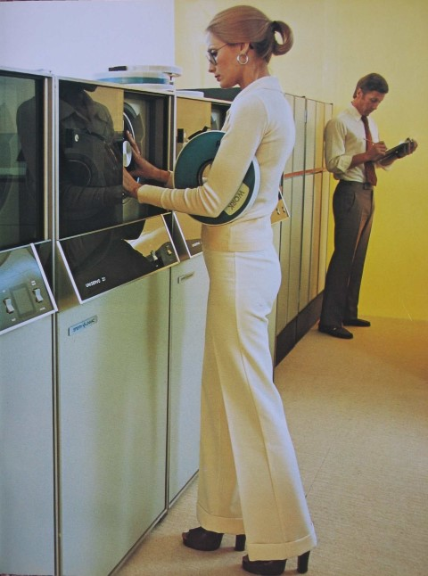
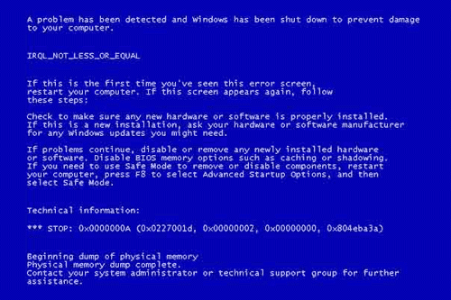

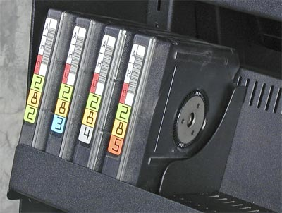
Business Continuity Problem
Enabling the application to continuously operate during unplanned and planned disruptive events

Slide 12
The importance of business continuity Impact from infrastructure outages
Source: IDC: Measuring Cost of Downtime and Recovery Objectives Among U.S. Firms, IDC QuickPoll Survey July 2013 and Storage User Demand Study 2013
Notes:
Slide Goal: Demonstrate that downtime is expensive for everyone, and that the cost of downtime grows exponentially with the amount of data in a workload
Here’s some IDC data which shows the dramatic impact downtime can have on a business. Even workloads with less than 50 TB of data suffer $200,000 in costs per hour of downtime. While workloads with large amounts of data can easily surpass costs of $1,000,000 per hour. While the costs your business faces may vary, it’s worth taking some time to gather information on those costs before data loss or downtime demonstrates them. Fully understanding these costs helps put the cost of protecting data and applications in perspective.

Slide 13
The Cloud Revolution Continues
>65%
40%
$127B
More than 65 percent of enterprise IT organizations will commit to hybrid cloud technologies before 2016¹
40 percent of partner revenue will come from cloud related products and services in 2 years
Public IT cloud services spending will reach $56.6 billion in 2014 and grow to more than $127 billion in 2018
Source:
1: https://www.idc.com/getdoc.jsp?containerId=prUS25350114
2: IDC eBook, sponsored by Microsoft, Successful Cloud Partners 2.0, May 2014
Notes:
More than 65% of enterprise IT organizations will commit to hybrid cloud technologies before 2016, vastly driving the rate and pace of change in IT organizations.
By 2017, IT buyers will actively channel 20% of their IT budgets through industry clouds to enable flexible collaboration, information sharing, and commerce.

Slide 14
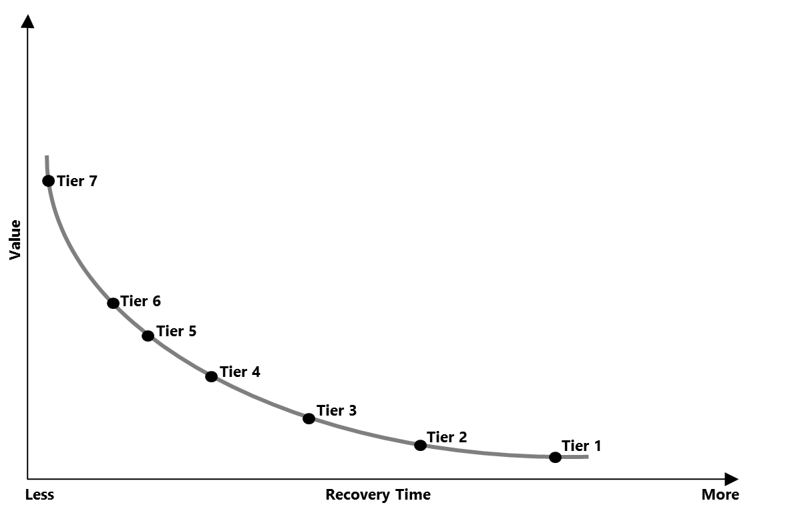
Safeguard your data & applications
SHARE Standards Group – 7 Tiers of Disaster Recovery
Tier 0 – No off-site disaster recovery plan
Tier 1 – Data backup with no hot site
Tier 2 – Data backup with hot site
Tier 3 – Electronic vaulting
Tier 4 – Point-in-time copies
Tier 5 – Transaction Integrity
Tier 6 – Zero or near-zero data loss
Tier 7 – Highly automated business integrated solution
Protect your data, your applications, based on your business needs
Notes:
But what, fundamentally, is Azure Site Recovery? Well, Azure Site Recovery can help you protect important applications by coordinating the replication and recovery of private clouds across sites, whether you’re protecting dozens – or hundreds of virtual machines. You can protect your applications to your own second site, a hoster’s site, or even use Azure as your disaster recovery site and avoid the expense and complexity of building and managing your own secondary location.
But where does this fit on the Seven Tiers of DR? The Seven Tiers of Disaster Recovery was originally defined by SHARE to help identify the various methods of recovering mission-critical computer systems as required to support business continuity. Although the original known published concept dates back to the 1990s, Business Continuity Planning (BCP) and Disaster Recovery specialists today continue to use the 7 Tiers to illustrate continuity capabilities and costs at a very high level. The definitions for the various Tiers have been updated as technology has evolved in support of today's business requirements and their associated Recovery Time Objective (RTO) and Recovery Point Objective (RPO).
Tier 0: No off-site data – Possibly no recovery
Businesses with a Tier 0 business continuity solution have no business continuity plan. There is no saved information, no documentation, no backup hardware, and no contingency plan. The time necessary to recover in this instance is unpredictable. In fact, it may not be possible to recover at all.
Tier 1: Data backup with no hot site
Businesses that use Tier 1 continuity solutions back up their data and send these backups to an off-site storage facility. The method of transporting these backups is often referred to as "PTAM" - the "Pick-up Truck Access Method." Depending on how often backups are created and shipped, these organizations must be prepared to accept several days to weeks of data loss, but their backups are secure off-site. However, this tier lacks the systems on which to restore data.
Tier 2: Data backup with a hot site
Businesses using Tier 2 business continuity solutions make regular backups on tape. This is combined with an off-site facility and infrastructure (known as a hot site) in which to restore systems from those tapes in the event of a disaster. This solution will still result in the need to recreate several hours or even days' worth of data, but the recovery time is more predictable.
Tier 3: Electronic vaulting
Tier 3 solutions build on the components of Tier 2. Additionally, some mission critical data is electronically vaulted. This electronically vaulted data is typically more current than that which is shipped via PTAM. As a result there is less data recreation or loss after a disaster occurs. The facilities for providing Electronic Remote Vaulting consists of high-speed communication circuits, some form of channel extension equipment and either physical or a virtual tape library and an automated tape library at the remote site. IBM's Peer-to-Peer VTS and Oracle StorageTek Virtual Storage Manager (VSM) Clustering are two examples of this type implementation.
Tier 4: Point-in-time copies
Tier 4 solutions are used by businesses that require both greater data currency and faster recovery than users of lower tiers. Rather than relying largely on shipping tape, as is common on the lower tiers, Tier 4 solutions begin to incorporate more disk based solutions. Several hours of data loss is still possible, but it is easier to make such point-in-time (PiT) copies with greater frequency than tape backups even when electronically vaulted.
Tier 5: Transaction integrity
Tier 5 solutions are used by businesses with a requirement for consistency of data between the production and recovery data centers. There is little to no data loss in such solutions; however, the presence of this functionality is entirely dependent on the application in use.
Tier 6: Zero or near-zero data loss
Tier 6 business continuity solutions maintain the highest levels of data currency. They are used by businesses with little or no tolerance for data loss and who need to restore data to applications rapidly. These solutions have no dependence on the applications or applications staffs to provide data consistency. Tier 6 solutions often require some form of Disk mirroring. There are various synchronous and asynchronous solutions available from the mainframe storage vendors. Each solution is somewhat different, offering different capabilities and providing different Recovery Point and Recovery Time objectives. Often some form of automated tape solution is also required. However, this can vary somewhat depending on the amount and type of data residing on tape.
Tier 7: Highly automated, business integrated solution
Tier 7 solutions include all the major components being used for a Tier 6 solution with the additional integration of automation. This allows a Tier 7 solution to ensure consistency of data above that which is granted by Tier 6 solutions. Additionally, recovery of the applications is automated, allowing for restoration of systems and applications much faster and more reliably than would be possible through manual business continuity procedures.
So where does Azure Site Recovery come in?
<click>
Tier 7. This means that Azure Site Recovery can offer the lowest levels of recovery time, and the highest value for customers, and when combined with the other components within the Microsoft solutions, helps customers to protect all of their mission critical applications and data.
<next slide>

Slide 15
Disaster recovery
Business Continuity Planning
Incident Response
Disaster Recovery
Application Lifecycle
Using Microsoft Azure as an integral part of your plan
Today we will look at a subset of DR.
We will cover:
What is “the Cloud”?
Azure basics?
Azure Backup
Azure IaaS Backup
Azure Site Recovery
Other tools & Services that you can use for DR

Slide 16
What is the cloud? A tool that will transform the datacenter
Build a
software-defined foundation
Automate and secure your infrastructure
On demand
Computing Resources
Notes:
Pillars Intro
Key Points:
First, look at where you make changes in your on-premises infrastructure. We’ll talk about how a software-defined approach can make you more agile.
Next, we’ll talk about how automation and security are key aspects of an overall approach to operational excellence
And finally, we’ll look at how hybrid capabilities can be added to your IT toolkit – to solve existing problems and make your job easier.
So how can you optimize your infrastructure? There are three areas where you have the opportunity to make changes that will reduce costs, simplify management, and allow you to access the cloud when it makes sense for your business.

Slide 17
Azure is compute availability on demand Solves IT challenges with the power of Microsoft Azure
Extend Your Datacenter
Achieve True Hybrid Cloud
Transform Your Business
Harness powerful cloud capabilities, turning IT into a differentiator
A unified platform across your datacenter and the cloud, making it easy to truly achieve a hybrid solution
Dynamically respond to the needs of your business with the elasticity of Azure and the convenience of a pay-as-you-go model

Slide 18
Cloud computing models
Infrastructure
( as a Service )
Platform
( as a Service )
Software
( as a Service )
On-Premises
You Manage
Data & Access
Data & Access
You Manage
Data & Access
Data & Access
You Provision & Manage
You Provision & Manage
Applications
Applications
Applications
Applications
Provisioned & Managed by Vendor
Runtime
Runtime
Runtime
Provisioned & Managed by Vendor
Runtime
Operating System
Operating System
Operating System
Operating System
Virtual Machine
Virtual Machine
Virtual Machine
Virtual Machine
Physical Fabric Managed by Vendor
Compute
You Provision Cloud Services
Compute
Compute
Compute
Networking
Networking
Networking
Networking
Storage
Storage
Storage
Storage
Host
Develop
Consume
Notes:
(Adjust timing to Audience)
Slide Objective: Explain the commonly accepted cloud computing models (IaaS, PaaS, and SaaS) in terms of an IT Pro’s responsibilities.
Key Talking Points:
When considering these cloud computing models, skilled IT Pros are needed to manage the components of each model that are unique to an organization:
(CLICK) Infrastructure as a Service: While the cloud vendor manages the physical hardware fabric for raw compute, networking and storage capacity, (CLICK) IT Pros provision IaaS for their organizational needs and (CLICK) continue to manage each provisioned virtual machine in a manner that is very similar to on-premises workloads.
(CLICK) Platform as a Service: In PaaS, the cloud platform vendor provisions and manages a consistent runtime environment upon which applications can be developed. (CLICK) IT Pros are needed in deploying and monitoring these applications, as well as managing access and protection of data.
(CLICK) Software as a Service: In SaaS, an organization is consuming an entire packaged application that is being delivered via the cloud. (CLICK) IT Pros are needed to manage access to these applications and the underlying data.
By choosing the best cloud computing model for each application need, depending on whether your organization needs to host, develop or consume an application, IT Pros can gain significant time-savings when managing applications that can then be applied to time investments in new strategic projects for an organization.
(CLICK) During this event, we will primarily be focusing on the IaaS Computing Model delivered via Windows Azure Infrastructure Services so that you can learn how to leverage the advantages of Windows Azure for hosting existing applications for your organization.

Slide 19











Cloud computing models
storage
cdn
traffic manager
cloud services
caching
identity
web sites
virtual machines
virtual network
vpn
mobile services
SQL database
media
IaaS
PaaS
SaaS
Infrastructure-as-a-Service
Platform-as-a-Service
Software-as-a-Service
host
develop
consume
Existing Applications
New Custom Applications
Packaged Applications
Notes:
(Adjust timing to Audience)
Slide Objective: Explain the commonly accepted cloud computing models (IaaS, PaaS, and SaaS) and appropriate use cases for each.
Suggested Approach: Familiarity with Cloud Models varies from audience-to-audience. Prior to presenting slides 8, 9 and 10, poll the audience by asking leading questions, such as:
What is a Cloud?
What is the difference between Virtualization and a Cloud? ( Cloud adds pooled resources, elasticity, self-service management, automation, and charge-back/show-back )
What is the difference between IaaS, PaaS and SaaS?
Based on attendee responses, adjust timing for presenting Slides 8, 9 and 10 to accommodate.
Key Talking Points:
The Windows Azure cloud platform aligns to all 3 accepted cloud computing models for delivering infrastructure, platform services and software as a service.
Microsoft is the only platform vendor that provides customers the compatibility, portability and choice of leveraging On-Premises, IaaS, PaaS and SaaS as an integrated offering
With this in mind, it’s important to understand how to talk about our Cloud Services offerings:
The industry has defined three categories of services:
IaaS – a set of infrastructure level capabilities such as an operating system, network connectivity, etc. that are delivered as pay for use services and can be used to host applications.
(CLICK) IaaS is often leverage to host existing applications on a cloud platform to provide lower cost, higher scalability or more flexible resource management.
Examples of Microsoft IaaS offerings include Windows Azure Virtual Machines, Storage and Virtual Networks.
PaaS – higher level sets of functionality that are delivered as consumable services for developers who are building applications. PaaS is about abstracting developers from the underlying infrastructure to enable applications to quickly be composed.
(CLICK) PaaS platforms are used by organizations to more cost effectively build and deploy new applications to the cloud without being concerning about underlying infrastructure complexities.
Examples of Microsoft PaaS solutions include Azure Web Roles, Worker Roles, Azure Database, and Azure Mobile Services
SaaS – applications that are delivered using a service delivery model where organizations can simply consume and use the application. Typically an organization would pay for the use of the application or the application could be monetized through ad revenue.
(CLICK) SaaS platforms delivered packaged applications as cloud services.
Examples of Microsoft SaaS solutions include Azure Web Site and Office 365.
It is important to note that these 3 types of services may exist independently of one another or combined with one another.
SaaS offerings needn’t be developed upon PaaS offerings although solutions built on PaaS offerings are often delivered as SaaS.
PaaS offerings also needn’t expose IaaS and there’s more to PaaS than just running platforms on IaaS.
It’s important to note that this slide doesn’t present a complete list of all possible cloud services that Windows Azure can provide, as this list is constantly growing. Instead, the slide presents

Slide 20




Summary: Azure cloud offerings
Over 100 services, continuous evolution
Data Factory
Traffic manager
Analytics
Event Hubs
SQL Database
SQL Data Warehouse
DocumentDB
Search
ExpressRoute
Machine Learning
HDInsight
Virtual Machines
Cloud Services
Batch
RemoteApp
Storage
StorSimple
Redis Cache
Virtual network
Azure AD
Multi-Factor
Backup
Site Recovery
Service bus
BizTalk
Scheduler
Automation
Op Insights
DNS
Web Apps
Mobile Apps
Notification Hubs
API Management
Mobile Engagement
App Service
API Apps
Logic Apps
Key Vault
App Gateway
VS Online
VS App Insights
Media Service
Media Intelligence
Media Encoding
Media Protection
Media Player
Media Streaming
CDN
VPN Gateway
Notes:
But that is not all that you can do with Azure. Windows Azure also provides infrastructure services which allow for more hands on configuration and management similar the servers you have today. However, they’re hosted in Microsoft datacenters letting you use Azure as if you were operating your own datacenter in the Cloud. For example, you can provision VMs, give them private IP addresses, and connect to them using a VPN from your on-premises environment. Most importantly, this lets Windows Azure mimic your on-premises datacenter and run your current apps with little or no change without the expense of having to own servers of racks, cooling and building costs. Furthermore, you can connect the “datacenter” you build in the Cloud to your on-premises datacenter so the datacenter in the Cloud becomes an extension to your on-premises infrastructure.
These “building blocks” lets Windows Azure to be used as an Infrastructure-a- a-service.
So, you see Windows Azure offers IaaS +PaaS in one platform. IaaS provides flexibility, PaaS eliminates complexity. Use PaaS where you can, use IaaS where you need. With Azure, you can use both together or independently, and build apps of the future. That uniquely differentiates us.

Slide 21
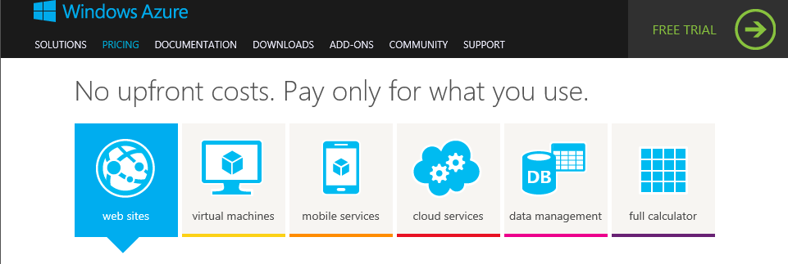
Estimating cloud costs
http://www.windowsazure.com/en-us/pricing/calculator/

Slide 22
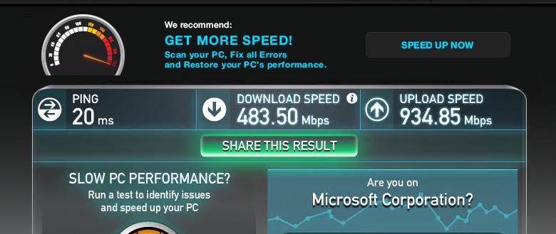
Well connected…

Slide 23





Microsoft’s datacenter evolution
1989-2005
2007
2009
2012
2015
Generation 1
Generation 2
Generation 3
Generation 4
Generation 5
2.0+ PUE
1.4 – 1.6 PUE
1.2 – 1.5 PUE
1.12 – 1.20 PUE
1.07 – 1.19 PUE
Colocation
Density
Containment
Modular
SW-Defined
Server
Capacity
20 year Technology
Rack
Density & Deployment
Minimized Resource Impact
Containers, PODs
Scalability & Sustainability
Air & Water Economization
Differentiated SLAs
ITPACs & Colocations
Reduced Carbon Right-Sized
Faster Time-to-Market
Outside Air Cooled
Fully Integrated
Resilient Software
Common Infrastructure
Operational Simplicity
Flexible & Scalable
Notes:
Microsoft has been building and operating datacenters since 1989, and hosting online services since 1994 (with MSN, followed by Hotmail). And over the course of that journey we’ve focused on flexibility, scalability, and efficiency in the design of our datacenters. So let’s talk for a moment about how we evolved the optimization of our datacenters for greater efficiency, scalability, and reliability.
In our first facilities, which we term Generation 1, we were often housed in third party colocation environments, where we deployed servers one at a time into pre-existing racks. This design was aimed at filling immediate capacity demands and the technology behind that was pretty antiquated. Today, many traditional datacenters are still built and managed in this manner.
When we really started seeing a big uptick in our online services around 2006 and 2007, we realized that we needed to be building more efficient facilities; from an energy standpoint, a water standpoint and also from the standpoint of operational efficiencies. And so we focused on designing a new class of datacenters. What we called Generation 2. In that generation, we were able to roll in pre-populated racks, fully configured with all the servers in them. We also focused on creating a dense environment, where we could use all of our resources very efficiently. But we also cut down tremendously on the resource utilization and we designed facilities that had Power Utilization Effectiveness (PUEs) of 1.4 to 1.6. That was a huge improvement in a very short time frame.
In 2009, we opened our first Generation 3 datacenter in Dublin, Ireland. That facility had a PUE of 1.2. How did we get there? We got there by using what we call containment: separating the hot air aisle from the cold air aisle in the datacenter. It was both simple and elegant, in that it allowed us to use outside air economization. Which means basically running the datacenter with the windows open to let free air cool the servers and not having to rely on electrical power to cool the datacenter environment (other than the fans which moved the air).
A few years later, when we evolved our datacenter designs to what we call Generation 4. We wanted to take it our efficiency and scalability to the next level and also focused on how we could modularize our entire supply chain. We began to think holistically about the electrical infrastructure, the server infrastructure, and also right-sizing our entire cloud infrastructure investment for enabling the fastest time-to-market. We retained our air cooled performance and we were able to drive our PUE down to between 1.15 and 1.20.
What’s next? Today, we are building our Generation 5 datacenters that are focused on enabling a software-defined cloud infrastructure that brings all of these elements together, and provides tighter integration between the application stack and the datacenter infrastructure. Generation 5 focuses on resilient software, common infrastructure, operational simplicity, and delivering class-leading flexibility and scalability in our design, while further driving our energy efficiency to PUEs in the 1.07 to 1.19 range.

Slide 24
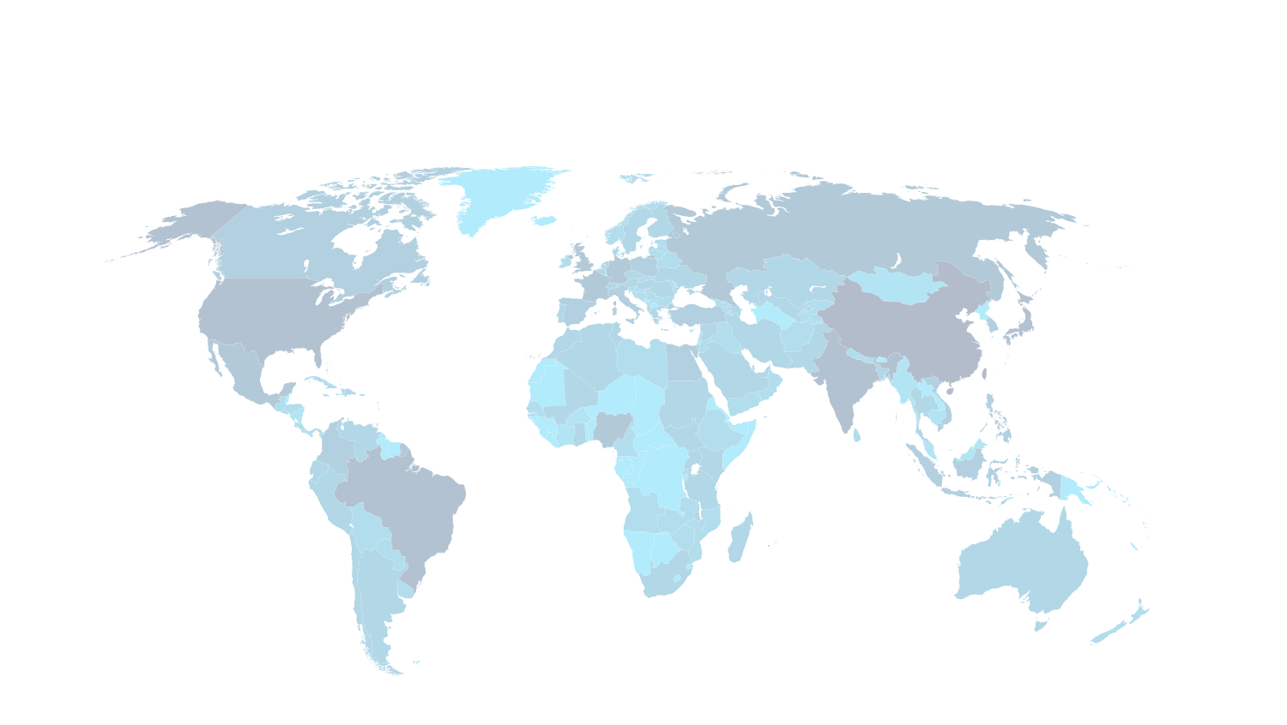












Internet connectivity by country
Microsoft’s global datacenter footprint
Microsoft global datacenter footprint
Microsoft Azure datacenter regions
Microsoft’s network is one of the two largest in the world
Internet users
■ 500,000,000+
■ 100,000,000 – 499,999,999
■ 50,000,000 – 99,999,999
■ 25,000,000 – 49,999,999
■ 5,000,000 – 24,999,999
■ 100,000 – 4,999,999
■ 50,000 – 999,999
■ 0 – 49,999
*Operated by 21Vianet
1 million+ servers • 100+ Datacenters in over 40 countries
Notes:
Over the last few years we’ve built a huge infrastructure (of datacenters and networks), that has enabled us to grow our cloud services at scale around the globe.
First view: Let’s start by looking at where Internet usage is highest—as this map fills in, you can see high Internet usage in the places we would expect, like the United States and Europe. But also notice the high usage in the countries of India and China.
<click>
Today, Microsoft has a global portfolio of more than 100 datacenters that are located in more than 40 countries worldwide. The locations on this map show the datacenters that are representative of our cloud infrastructure footprint. For security reasons, we don’t share the exact location of our datacenters or the exact number that we own and manage.
<click>
This next view shows the 19 Microsoft Azure regions (and datacenters) that host data for our Azure customers.
These regions each have multiple datacenters within them. This enables Microsoft to offer geo-redundancy within the region to maintain high availability, while helping customers maintain their compliance requirements.
All Microsoft Azure datacenters are paired with another datacenter that's physically separated by hundreds of miles. Data is asynchronously replicated between the two datacenters (when the storage account is enabled for geo-replication) to help protect against an Azure site failure.

Slide 25












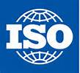
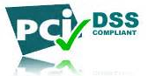

Microsoft Cloud compliance certifications and attestations
Regulatory and Compliance Domain
CJIS | Yes | No | Yes | No | No
EU Model Clauses | Yes | Yes | Yes | Yes | No
EU Safe Harbor | Yes | Yes | Yes | Yes | Yes
FedRAMP (Moderate) | Yes | No | Yes | No | No
FERPA | Yes | Yes | Yes | N/A | Yes
HIPAA BAA | Yes | Yes | Yes | Yes | No
US Government Cloud | Yes | Yes | Yes | No | No
UK G-Cloud (OFFICIAL) | Yes | Yes | Yes | No | No
ISO 27001:2013 (w/ISO 27018:2014 | Yes | Yes | Yes | Yes | Yes ISO 27001:2005
PCI DSS Level 1 | N/A | N/A | Yes | N/A | N/A
SOC 1 Type 2 (SSAE 16 / ISAE 3402) | Yes | Yes | Yes | Yes | No
SOC 2 Type 2 (AT Section 101) | Yes | No | Yes | Yes | No
as of 01/15/15
Notes:
Certifications and attestations represent verification that control activities operate in accordance with expectations. Operating a huge global cloud infrastructure, across many businesses, comes with the need to meet an array of compliance and regulatory obligations. With this in mind, Microsoft products and services hold key certifications, attestations, and authorizations as applicable to their service.
The certifications and attestations listed on this slide are in alphabetical order. Several key ones deserve to be highlighted:
Our ISO 27001 certification provides assurance of a broad, risk-based information security program. Microsoft Cloud Infrastructure and Operations—the organization that builds, manages, and secures our datacenters globally—was the first major cloud service infrastructure to be certified for ISO 27001.
Microsoft’s Cloud Infrastructure & Operations (MCIO) team has gone beyond the ISO/IEC 27001:2005 standard (which includes some 150 security controls) to develop over 800 defense-in-depth security controls to account for the unique challenges of the cloud infrastructure and what it takes to mitigate some of the risks involved.
We have SSAE 16/ISAE 3402 SOC 1, 2, and 3 attestations in place. These attestations are both type I and type II. They provide assurance of effective control performance.
In 2012, Microsoft became one of the first in the industry to successfully complete a SOC 2 Type 2 and SOC 3 audit (which are designed to better accommodate cloud services) for our cloud infrastructure (datacenters and networks). We continue to demonstrate compliance through ongoing assessments.
In 2008, Microsoft was the first major cloud service provider to receive a SAS 70 report (the predecessor to SOC reports) for our cloud infrastructure.
Microsoft was an early adopter of the SOC 1, SOC 2 and SOC 3 in 2011. The SOC audit reports attest to the design and operating effectiveness of controls related to security, availability, and confidentiality.
We meet the US HIPAA/HITECH health data protection requirements and have incorporated those requirements into our ISO 27001 program. Microsoft was the first major productivity cloud service vendor to offer a HIPAA Business Associate Agreement (BAA) to healthcare entities with access to Protected Health Information (PHI). We have since extended that to offer a single HIPAA BAA for all of our commercial online services.
We meet the Payment Card Industry Data Security Standard as an infrastructure provider.
Microsoft’s first FISMA Authorization to Operate (ATO) was granted in 2010 for the MCIO cloud organization. Since then, Microsoft enterprise cloud services, including Office 365 and Microsoft Azure, have received provisional authorities to operate (P-ATOs) by the Federal Risk and Authorization Program (FedRAMP) Joint Authorization Board (JAB).
In the United Kingdom, Azure was awarded Impact Level 2 (IL2) accreditation, further enhancing Microsoft and its partner offerings on the current G-Cloud procurement Framework and CloudStore.
The industry organization Cloud Security Alliance (CSA) created a Cloud Controls Matrix to identify primary criteria for service offerings. Microsoft was the first cloud service provider to complete a third-party assessment against the Cloud Security Alliance (CSA) Cloud Controls Matrix (CCM) as part of its SOC 2 audit for Azure. This assessment was completed as a means of meeting the assurance and reporting needs of the majority of cloud services users worldwide.
We have incorporated many other obligations to our compliance program, providing assurance that we are able to meet obligations such as the European Union Data Protection Directive and California Senate Bill 1386, such as the European Union Data Protection Directive and California Senate Bill 1386.

Slide 26
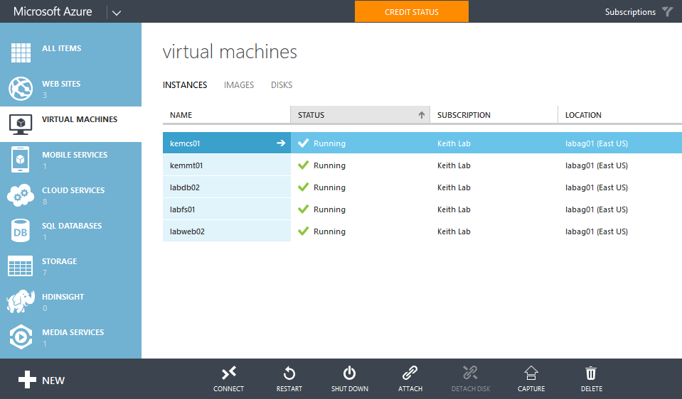
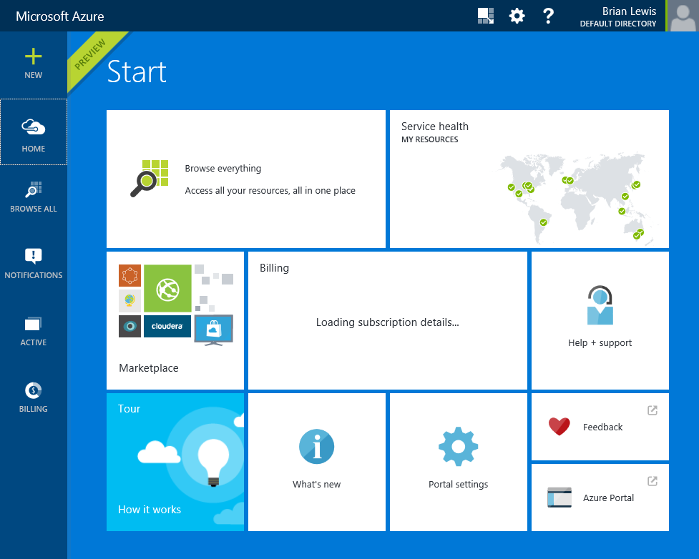
Demo: Introduction to Microsoft Azure
Notes:
Login to portal and show how to create a new VM
From VM already running show a speedtest. For good reliable results us a DS2 machine and a flash test site.

Slide 27
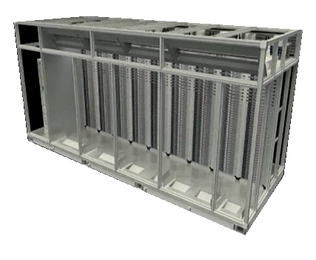
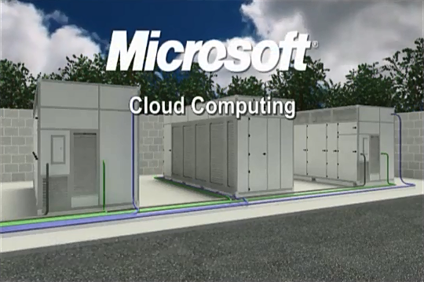
ITPAC – How Microsoft builds Azure datacenters
ITPAC ( IT Pre-Assembled Components )
Generation 4 Cloud Datacenters
aka.ms/itpac
aka.ms/msdatacenters
Notes:
Slide Objective: Discuss how Microsoft builds Windows Azure datacenter for quickly scaling physical capacity
Key Talking Points:
To support growth in the massive demand for Windows Azure, Microsoft has developed a modular approach to building and expanding physical datacenter capacity quickly – in days, instead of weeks and months
ITPACs are pre-assembled, self-contained datacenter “pods” that contain pre-wired racks of servers, storage and networking equipment along with cooling, venting and power management.
Multiple ITPACs can be quickly delivered to a datacenter site and interconnected to build and/or grow datacenter capacity
By leveraging ITPACs as building blocks for modular datacenters, not only can Microsoft quickly expand physical capacity, but existing capacity is delivered very cost-effectively – in our Gen4 datacenters, we’ve demonstrated a 1.05 PUE ( Power Utilization Efficiency) ratio – whereas traditional datacenters often have a PUE as much as 2-3x higher.
Direct attendees to the links on the page for more details. If time permits during the event, you may wish to play one or both videos.
Additional Resources:
United Nations ITPAC datacenter technology video - http://www.microsoft.com/en-us/showcase/details.aspx?uuid=0d0d24d6-f637-4b50-b118-5c8a0f5bf614
Microsoft Generation 4.0 Data Center Vision - http://www.youtube.com/watch?v=PPnoKb9fTkA

Slide 28
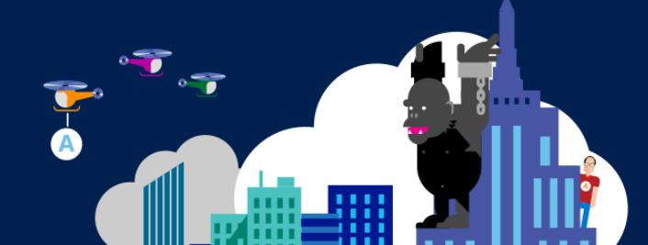
VIDEO
Microsoft Azure Datacenter Tour
Notes:
Datacenter Tour Video

Slide 29
Microsoft Azure storage
Persistent Cloud Storage
Highly Durable and Scalable
Continuous Geo-Replication
Cloud Storage Scenarios
Data & Access
Applications
Runtime
Operating System
Virtual Machine
Compute
Networking
Provision
Storage
Notes:
Slide Objective: Introduce topic areas for this module.

Slide 30
Microsoft Azure storage
50+ trillion objects
“Microsoft consistently performed better than Amazon. It delivered the best speeds across small and medium-sized files and, in some cases, beat Amazon by nearly 2x.”
– Nasuni 2015 State of the Cloud Storage Report
Notes:
Slide Objective: Introduce the value of Microsoft Azure Storage.
Key Talking Points:
Microsoft Azure Storage has over 50 trillion objects, processes an average of 270,000 requests per second, and reaches peaks of 880k requests per second!
Microsoft Azure Storage system is the underpinning to everything in Azure that requires storage. The Microsoft Azure storage system provides a solid robust data platform for different services that make use of it – Blobs, Tables and Drives.

Slide 31




Storing data on Windows Azure
Windows Azure Storage
Notes:
(SLIDE CONTAINS BUILDS OF THE NEXT THREE SLIDES)
Slide Objective: Highlight Windows Azure Durable Storage
Key Talking Points:
When data is written to Windows Azure storage, it is stored in way that it is very reliable, consistent, and delivers high performance.
Replication
We triple replicate all storage writes within a Storage Stamp across at least 3 independent rack locations ( synchronously ).
If a physical disk fails, we have two other copies of the data that we can work with and we do not have any interruption of service
We can then spin up a new replica in the background
From your application’s perspective you never know that an issue actually occurred
[build]
So you get much more reliability and an always-on experience even when hardware fails
Notes:
Mention that Windows Azure Virtual Machines are backed by Windows Azure Storage as a durable store.

Slide 32

Storing data on Windows Azure
Windows Azure Storage
Highly Durable Storage
Notes:
( CONTINUED BUILD FROM PRIOR SLIDE )

Slide 33
Increased availability with replication
Geo-Replicated Storage
WEST
DC
EAST
DC
> 250 miles
continuous storage geo-replication
Windows Azure Storage
Notes:
Slide Objectives:
Describe Geo-replication
Key Talking Points:
Another thing that is nice about the Windows Azure Storage solution is that we have support for Continuous storage geo-replication
What this means is that whenever you save something in the storage system, in the background we can automatically replicate the data to another datacenter with the same datacenter region ( asynchronous transactional replication ).
We guarantee that these data centers are several hundred miles apart so that in the case of a natural disaster or a complete data center failure you can be ensured that a copy of your data exists somewhere else.
Single check-box option when provisioning storage - automatically enabled by default.
You can turn it off if there are policy reasons why you wouldn’t want it enabled.
Be careful when turning replication on after storage provisioning – customers are charged for the network traffic associated with initial replication between datacenters when enabled post-provisioning.
The end result is that you can deliver more robust solutions with even greater integrity
Failover between sites is currently coordinated by Microsoft.
Secondary read-only access to geo replicated storage (RA GRS) is now available as a Preview feature, at a slightly higher cost over geo-replicated storage (GRS). Details are available at http://www.windowsazure.com/en-us/pricing/details/storage/

Slide 34
Accessing blob storage
https://<account>.blob.core.windows.net/<container>/<blobname>
Account
Container
Blob
Pages/ Blocks
vhds
VM01.VHD
Page (1TB)
contoso
Block (4MB)
videos
VID1.AVI
Block (4MB)
Notes:
Slide Objectives
Understand the hierarchy of Blob storage
Key Talking Points
The Blob service provides storage for entities, such as binary files and text files.
The REST API for the Blob service exposes two resources:
Containers
Blobs.
A container is a set of blobs; every blob must belong to a container.
The Blob service defines two types of blobs:
Block blobs (Max size = 200GB), which are optimized for streaming ( each block can be variable in size, up to 4MB per block )
Page blobs (Max size = 1TB), which are optimized for random read/write operations and which provide the ability to write to a range of bytes in a blob ( each page can be variable in size, up to 1TB per page )
Blobs can be read by calling the Get Blob operation. A client may read the entire blob, or an arbitrary range of bytes.
Block blobs less than or equal to 64 MB in size can be uploaded by calling the Put Blob operation.
Block blobs larger than 64 MB must be uploaded as a set of blocks, each of which must be less than or equal to 4 MB in size.
Page blobs are created and initialized with a maximum size with a call to Put Blob.
To write content to a page blob, you call the Put Page operation. The maximum size currently supported for a page blob is 1 TB.
When using Read-only Access to Geo-Replicated Storage (RA GRS), access to the replicated secondary storage can be accomplished via a REST URI that appends “-secondary” to the account name (ie., https://account-secondary.blob.core.windows.net/ )
Notes
http://msdn.microsoft.com/en-us/library/dd179355.aspx
Using the REST API for the Blob service, developers can create a hierarchical namespace similar to a file system. Blob names may encode a hierarchy by using a configurable path separator. For example, the blob names MyGroup/MyBlob1 and MyGroup/MyBlob2 imply a virtual level of organization for blobs. The enumeration operation for blobs supports traversing the virtual hierarchy in a manner similar to that of a file system, so that you can return a set of blobs that are organized beneath a group. For example, you can enumerate all blobs organized under MyGroup/.

Slide 35
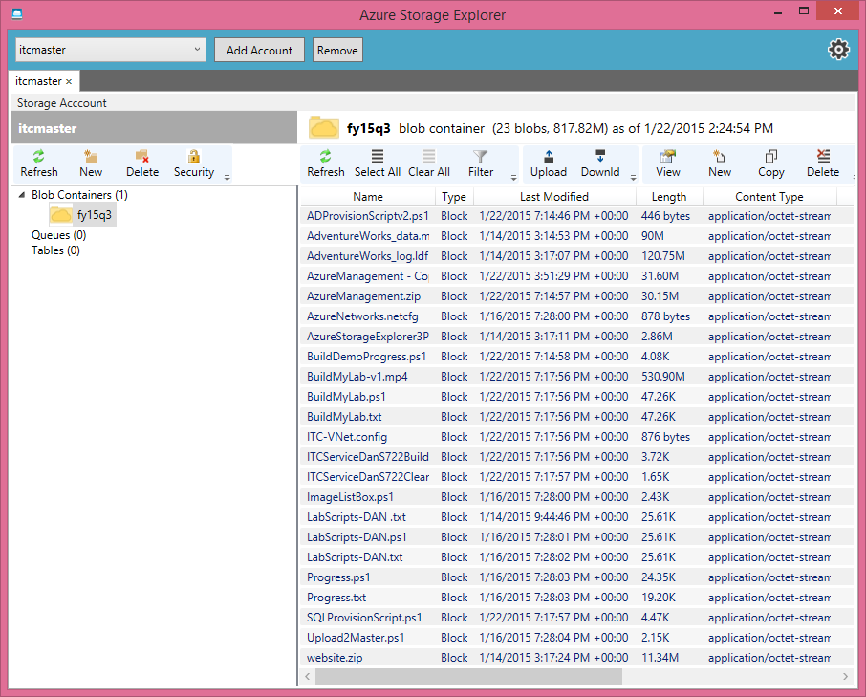
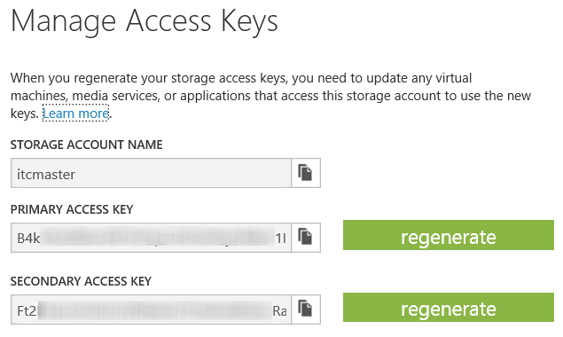
Managing storage
Storage explorers require the Azure storage key
Direct web access: https://<your-term>.blob.core.windows.net/
Azure Copy
PowerShell
Manageable through many third party tools
http://aka.ms/AzureStorageExploers
Notes:
http://blogs.msdn.com/b/windowsazurestorage/archive/2014/03/11/windows-azure-storage-explorers-2014.aspx

Slide 36
DEMO
Microsoft Azure Storage
Notes:
Demo Objective: Step through the process of provisioning a new Microsoft Azure Storage Account
Optional: show Cloudberry Explorer for Azure

Slide 37

Break Time: Lab 0: Login to the Azure Portal

Slide 38
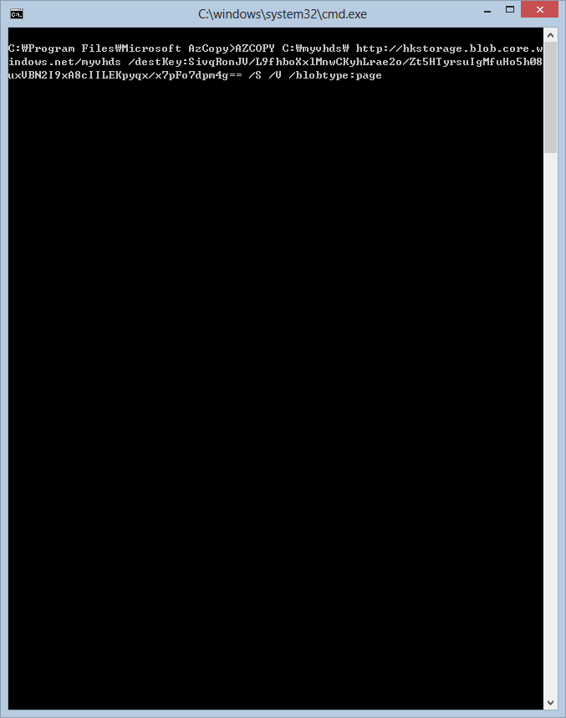
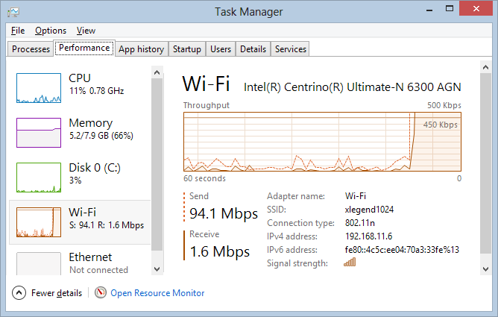
Azcopy tool
Command line tool
Fast copies
Server to server
Multiple files
Azcopy provide fast upload so that you can save time
Use Azcopy to upload your VHD
AZCOPY
C:\myvhds\
http://hkstorage.blob.core.windows.net/myvhds
/destKey:yourblobstoragekey
/S
/V
/blobtype:page
Blobtype should be specified

Slide 39
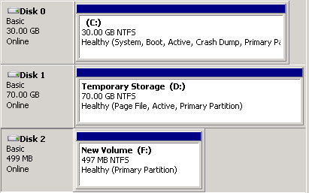
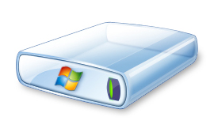
AZcopy process overview for VMs
Command line tool
Windows Azure
On-premise
Virtual Machine
1
Upload VHD
Files
3
Attach Disk
2
Create Disk
Files
Windows Azure Blob Storage

Slide 40
DEMO
AZcopy.exe

Slide 41
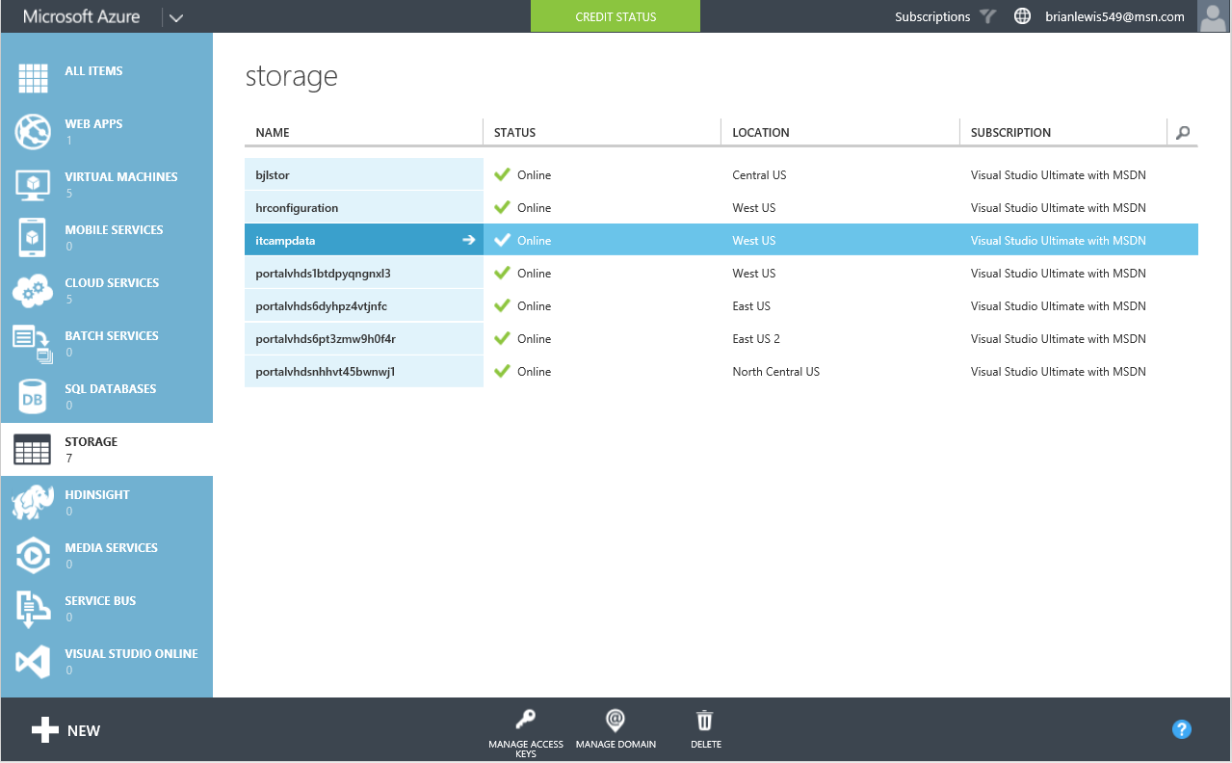
Review: Azure Storage
Azure Portal
Azure Copy “Azcopy.exe”
PowerShell
Storage explorer
Notes:
Storage managed through many third party tools
http://blogs.msdn.com/b/windowsazurestorage/archive/2014/03/11/windows-azure-storage-explorers-2014.aspx

Slide 42

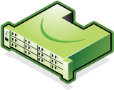



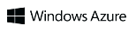
Microsoft StorSimple Hybrid Cloud Storage
Connects On-Premises Servers to Azure Storage in Minutes with No Application Modification
Application Servers
Most Active Data on SSD
Benefits
Consolidates primary, archive, backup, DR thru seamless integration with Azure
Cloud snapshots = revolutionary speed, simplicity and reliability for backup and recovery
Reduces enterprise storage TCO by 60–80%
Storage de-duplicated, compressed and encrypted before writing to Azure Storage.
SAS Local Tier
Speed of SSD/SAN + Elasticity of Cloud
Inactive Data + Backup Copies on Azure storage
Notes:
Video Demo available here: aka.ms/StorSimpleDemo
Slide Objective: Introduce Cloud-Integrated Tiered Storage via Microsoft StorSimple.
Key Talking Points:
Typically only 15% of an organization’s total storage is actively used, but most organizations pay for enough storage to store 100% of their data on-premises, also complicating the backup strategy.
StorSimple is a Cloud-Integrated iSCSI SAN Appliance
Includes SSD, SAS, NL-SAS and Windows Azure Storage Tiers
Dynamically identifies hot, warm, cold storage at a block level
Hot and warm data remains on appliance in SSD and SAS storage tiers
Cold data blocks are randomized, obfuscated and encrypted using on-premises encryption keys before sending to Azure storage
Can be leveraged as Disk-to-Disk storage location for on-premises backups
Cloud snapshots – send snapshots to offsite storage locations
Data can be restored to same or alternate datacenter locations.
Additional Resources:
ChalkTalk Video - http://www.youtube.com/watch?v=Xxi6FBJQA_M&feature=youtu.be
Demo Video – http://aka.ms/StorSimpleDemo

Slide 43
Common Workloads for StorSimple
Target Use Cases
CapEx, OpEx of traditional storage
File Share
File servers
NAS
CIFS
NFS
SharePoint
Collaboration
Content & records management
Business intelligence
Data grows exponentially (50–60% Annually)
Cloud Storage
Capacity
CapEx, OpEx of StorSimple
Archives
Media
Engineering
Logs, records
EMR/PACS
Legal
Construction
However, most I/O happens to “working set” data
VMs
Local Storage
VM sprawl
VM archives
Regional office storage
Time
Notes:
Slide Objective: Discuss target use cases for StorSimple Hybrid Cloud Storage
Key Talking Points:
Most common use cases are document-oriented and archive storage. These are use cases where lots of data needs to be retained, but frequently only a small portion of the overall dataset is actively accessed.

Slide 44

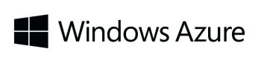

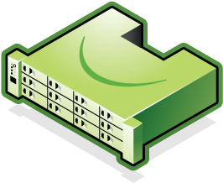
Cloud Snapshots Provide Rapid Recovery
Cloud
Snapshots
Production Data
Production Data
Enterprise Data Center 1
Enterprise Data Center 2
Connect many servers to cloud storage and scale data sets with StorSimple solution
Rapidly recover to any data center (location independent) via mounting the cloud
Notes:
Slide Objective: Discuss rapid recovery capabilities provided by StorSimple in the event of a datacenter outage.

Slide 45






Hybrid Cloud Storage Cost Comparison
Traditional Storage + Data Protection Architecture
Hybrid Cloud Storage (StorSimple + Windows Azure)
Servers
Servers
Primary Volume
Disk Array ($100K; Double if Replicated)
Primary Volume
Snapshot
Disk Backup/ VTL
($100K; double if replicated)
Local Snapshot
50 TB
Media Server ($25K)
Encryption Appliance
Extended Primary + Cloud Snapshots to nearby cloud storage service region
Physical Tape Infrastructure ($50K)
Offsite Vault
Traditional
CapEx: $375K | Support: $75K per Year
Windows Azure + StorSimple
CapEx: $0K | Support & Cloud: $55K per Year
Notes:
Slide Objective: Compare Traditional Storage vs Hybrid Cloud Storage costs.

Slide 46
Microsoft Azure Backup
Simple and reliable server backup to the cloud
Reliable offsite data protection
A simple and integrated solution
Efficient backup and recovery
Convenient offsite protection
Safe data
Encrypted backups
Familiar interface
Windows Azure integration
Efficient use of bandwidth and storage
Flexible configuration
Flexibility in recovery
Cost-effective and metered by usage
Notes:
Microsoft Azure Backup helps protect server data against loss and corruption by enabling backup to offsite cloud storage in Microsoft Azure.
The service delivers on three key values – reliable offsite data protection, a simple and integrated solution, and efficient backup and recovery. Let’s look at each of these in turn.
Reliable offsite data protection
Convenient offsite protection: Local backups leave data vulnerable to unfortunate events such as fire. Continuously migrating backup media offsite can be inconvenient. Azure Backup provides convenient, automated offsite data protection that stores data safely away from your premises, reducing the need to secure and protect onsite backup media.
Safe data: Data stored in Microsoft Azure is geo-replicated among Azure data centers, for additional protection.
Encrypted backups: Your data is encrypted before it leaves your premises, and remains encrypted in Azure – only you have the key.
A simple and integrated solution
Familiar interface: Small businesses protecting a single or few servers, can use familiar Windows Server in-box backup tools to protect data, manually or on a regular, automated schedule. Larger organizations with System Center 2012 can use the Data Protection Manager component to centrally manage backups across multiple servers.
Windows Azure integration: Azure Backup is fully integrated with the Azure Management Portal for sign-up, billing, and web-based management.
Efficient backup and recovery
Efficient use of bandwidth and storage: Azure Backup conserves WAN bandwidth and Azure storage by sending only changes to files with incremental backups.
Flexible configuration: Configurable data retention policies, data compression, and data transfer throttling provide for both flexible backup policies and backup efficiency.
Flexibility in recovery: Incremental backups enable point-in-time recovery of multiple versions of the data. Plus, you can recover just what you need with file-level recovery.
Cost-effective: Azure Backup helps you control costs by reducing the need for local storage and offsite media management, while benefiting from simple storage-based pricing with no per-server or data transfer fees.

Slide 47
Protection that evolves with your IT IT solutions are evolving – your business continuity should too
Physical
Virtual
Hybrid Cloud
Cloud
On-premises—built and managed infrastructure
Cloud—flexible, remote infrastructure
Microsoft provides solutions across all four scenarios
Notes:
Presentation Notes: Start the presentation with this slide to gauge where a prospect is in their journey to cloud adoption, what their long-term vision looks like and their timeline. This will open up a conversation on their current state, their desired future state, and impediments that stand in their way. As they explain their current state – ask them what products they currently use in their environment for backup, replication and disaster recovery. If the prospect shares their vision above, strive to match our ability to fuel that vision with our solution’s heterogeneity (including cloud).
There will likely be one of two scenarios – 1.) Most likely scenario - they use multiple products for backup, replication and DR – perhaps even different products for differing infrastructure. 2.) They have an integrated solution for physical and virtual – but it doesn’t support cloud or offer DRaaS. If they have multiple products – the clear pitch is our heterogeneity and our ability to offer simplification with one solution – with the capabilities to support their future (cloud) needs, providing future validation to the “one solution” offering. If they have an integrated product and lack cloud capability – our angle is to highlight our cloud support, helping power their end-to-end vision, with less complexity.
The key selling motion around heterogeneity, is solving a “three tense” problem – past, present and future. Regardless of what stage a customer is at today, a move to the next stage will require their team take on new challenges/problems – BC/DR just one of many. We reduce that problem set by having BC/DR be one less solution on the list to learn and manage. Since we connect all stages together with the capabilities of ASR and InMage, we address planned infrastructure as well as their former, which gives us a unique position in the market.
EX: If the customer currently leverages physical infrastructure in combination with VMware Virtual Machines (Stage 2) and wants to move assets to the cloud in the next 12 months (stage 3) the best way to position the solution to the prospect would be to highlight the current capabilities of ASR with InMage starting with their existing site to site needs. Focus on the solution’s near zero downtime or data loss, with the ability to move and protect assets in the private cloud and Azure. Unlike others - ASR with InMage has the capabilities they need today, with the ability to support their future vision, already built in.

Slide 48

Microsoft solutions Breadth and depth solutions for business continuity and disaster recovery
Protect your data
Simplified protection with
Windows Server Backup (WSB)
Centralized backup with System Center Data Protection Manager (DPM)
Integration of WSB/DPM with Microsoft Azure Backup
2
Microsoft Azure
3
Safeguard your applications
Orchestrated physical, Hyper-V and VMware virtual-machine replication and recovery using Azure Site Recovery, between on-premises locations, or between on-premises and Microsoft Azure
}
Maintain availability
Hyper-V Failover Clustering for VM Resilience
Hyper-V Guest Clustering for app- level HA, i.e. SQL Server AlwaysOn FCI
1
Notes:
Firstly, when we think about our infrastructure fabric, features built into Windows Server, like Failover Clustering, ensure that in the event of a Hyper-V host failing, your virtual workloads running on top, will restart automatically on another available cluster node, without administrator intervention. For additional levels of application-level protection, customers can create guest clusters i.e. clusters inside the virtual machines, that ensure if individual VMs fail, their partner guest cluster nodes take over, ensuring a higher level of availability at the application level. An example here would be a SQL Server AlwaysOn Failover Cluster Instance. Both of these integrated capabilities help to maintain the highest levels of availability for key workloads.
<click>
For application and data protection, Windows Server Backup offers an inbox, small scale, simple protection solution for key applications, file and VM data. For more advanced, scalable, granular data and application protection, System Center Data Protection Manager provides a powerful solution for protection, across physical and virtual, with application-specific functionality built in, to protect Exchange, SQL Server, SharePoint, Hyper-V and more, all with a single agent. Both of these backup technologies integrate with Microsoft Azure Backup – a Microsoft Azure-based service enabling customers to embrace the cloud as an offsite repository for backing up their key data, all seamlessly integrated into the respective UI’s of WSB and DPM.
<click>
For customers looking to embrace a faster, VM-level failover between sites, Azure Site Recovery enables organizations to quickly and efficiently replicate their virtual machines to a secondary location, and build powerful recovery plans to orchestrate the failover to the second site, and back, in a controlled manner. In addition, with the recent acquisition of InMage, Microsoft has expanded it’s replication and recovery capabilities for Azure Site Recovery with support for replicating VMware vSphere-based VMs, or physical servers, to a secondary location running VMware vSphere. But what if you don’t have a second site of you own?
Well, with new capabilities added to Microsoft Azure Site Recovery, combined with additional integrated capabilities provided by InMage, customers also also have the opportunity to replicate and recover their physical servers, Hyper-V, or VMware vSphere-based VMs into Microsoft Azure, taking advantage of Microsoft’s cloud scale, reliability and redundancy.
What we have on the slide is just a taster of the capabilities that Microsoft can provide to help meet your business continuity and disaster recovery needs, so let’s take a look in more detail at each of these areas to understand a little more of how they work, and the advantages they can provide.
<next slide>

Slide 49
Protect your data Powerful solutions for Enterprise and SMB
Enhanced through integration with Microsoft Azure Backup
Scalable, centralized backup with System Center Data Protection Manager
Simplified protection and recovery, built into Windows Server with Windows Server Backup
With Microsoft, customers can recover quickly from human error, service outages, and disasters with cost-effective solutions that automate protection and recovery of key data and applications and that are cloud-integrated for reliable offsite protection.
Notes:
Now when it comes to data protection, Microsoft has a number of key solutions that enable customers to recover quickly from human error, service outages and disasters. These solutions are cost-effective solutions that automate protection and recovery of key data and applications and are cloud-integrated for reliable off-site protection.
On the left, you have Data Protection Manager, part of the System Center product. Data Protection Manager enables disk-based and tape-based data protection and recovery for servers such as SQL Server, Exchange Server, SharePoint, virtual servers, file servers, and support for Windows desktops and laptops. DPM can also centrally manage system state and Bare Metal Recovery or BMR. It’s also enhanced, as you’ll learn shortly, through integration with Microsoft Azure.
For smaller organizations, with less-complex protection requirements, Windows Server provides a powerful, in-box backup solution for protecting important data. Windows Server Backup provides a set of wizards and other tools for you to perform basic backup and recovery tasks for the server it is installed on, and, similar to DPM, has integration with Microsoft Azure Backup for reliable, offsite protection.
<click>
So, let’s dive a little deeper into each of these areas, starting with Data Protection Manager, to understand more of the key capabilities of the solution.
<next slide>

Slide 50
Protect your data Basic backup and recovery built into Windows Server
Simplified protection: Back up full volumes, selected volumes, system state, specific files, and folders.
Bare Metal Recovery: Fully recover a physical system.
Policies: Support backup versioning and simple, effective retention policies.
Virtual machines: Protect Hyper-V virtual machines whether they are running or not.
Flexible storage: Protect key data to local, including USB, or remote file server storage.
Simplified scheduling: Support automated backup once or multiple times per day.
Azure Backup integration: Reliable offsite data protection, integrated into the Windows Server Backup user interface.
Enhanced through integration with Microsoft Azure Backup
Simplified protection and recovery, built into Windows Server with Windows Server Backup
Recover quickly from human error, service outages, and disasters with cost-effective solutions that are cloud-integrated for reliable offsite protection.
Notes:
You can use Windows Server Backup to back up a full server (all volumes), selected volumes, the system state, or specific files or folders—and to create a backup that you can use for bare metal recovery. You can recover volumes, folders, files, certain applications, and the system state. And, in case of disasters like hard disk failures, you can perform a bare metal recovery. (To do this, you will need a backup of the full server or just the volumes that contain operating system files, and the Windows Recovery Environment—this will restore your complete system onto your old system or a new hard disk.)You can use Windows Server Backup to create and manage backups for the local computer or a remote computer. And, you can schedule backups to run automatically. Windows Server Backup is intended for use by everyone who needs a basic backup solution—from small business to large enterprises—but is even suited for smaller organizations or individuals who are not IT professionals.
Previously, Virtual machines were backed up as part of a volume backup. They could not be backed up or restored separately, however with 2012 and 2012 R2, When you select items to backup or recover you can now select individual virtual machines to include in the backup and to restore from a recovery point
also integrate with Microsoft Azure Backup, to offer an extra location for storage of key data backups. This provides the following benefits:
- Reduced costs—The Microsoft Azure Backup service can help to reduce the total cost of ownership (TCO) for customers by providing scalability, elasticity, and simplified storage management. - Peace of mind—The Microsoft Azure Backup service provides a reliable, secure, and a robust short-term offsite backup and restore solution that is highly available. - Simplicity—The Microsoft Azure Backup workflows are seamlessly integrated into the existing DPM backup, recovery and monitoring workflows.
Reliable offsite data protection
Backups are encrypted before transmission and stored encrypted in Azure. These backups are off-site, safely away from your datacenter, protected by reliable Azure storage, reducing the need to secure and protect on-site backup media.
A simple and integrated solution
Manage cloud backups from the familiar backup UI in System Center Data Protection Manager. These tools provide similar experiences configuring, monitoring, and recovering backups whether to local disk or Azure storage. Or you can use the agent software itself. After data is backed up to the cloud, authorized users can easily recover backups to any server.
Efficient and flexible backup and recovery
With incremental backups, only changes to files are transferred to the cloud. This helps ensure efficient use of storage and reduced bandwidth consumption, while enabling point-in-time recovery of multiple versions of the data. Configurable data retention policies, data compression, and data transfer throttling offer added flexibility and help boost efficiency.

Slide 51

Microsoft Azure Backup Extending Windows Server Backup into the cloud
Microsoft Azure
Reliable offsite data protection: Backups are encrypted before transmission and stored encrypted in Microsoft Azure.
Backups are off-site, away from your datacenter, protected by reliable Azure storage.
Contoso
Backup Vault
Simple, and integrated solution: Integrates with GUIs of Windows Server Backup or System Center Data Protection Manager.
Efficient and flexible backup and recovery: Incremental backup transfers only delta changes to the cloud.
Supports Point-in-Time Recovery of multiple versions of your data.
Configurable data retention policies, data compression, and data transfer throttling offer added flexibility and efficiency.
Encrypted data sent to Microsoft Azure
Windows Server instances with the Microsoft Azure Backup Agent installed and configured
Contoso Private Cloud (On-premises)
Notes:
By integrating Windows Server Backup with Microsoft Azure Backup, customers can protect their important data off-site, by harnessing Microsoft Azure.
Azure Backup helps you protect important server data off-site with automated backup to Azure.
Reliable offsite data protection
Backups are encrypted before transmission and stored encrypted in Azure. These backups are off-site, safely away from your datacenter, protected by reliable Azure storage, reducing the need to secure and protect on-site backup media.
A simple and integrated solution
Manage cloud backups from the familiar backup tools in Windows Server, Windows Server Essentials, or System Center Data Protection Manager. These tools provide similar experiences configuring, monitoring, and recovering backups whether to local disk or Azure storage. Or you can use the agent software itself. After data is backed up to the cloud, authorized users can easily recover backups to any server.
Efficient and flexible backup and recovery
With incremental backups, only changes to files are transferred to the cloud. This helps ensure efficient use of storage and reduced bandwidth consumption, while enabling point-in-time recovery of multiple versions of the data. Configurable data retention policies, data compression, and data transfer throttling offer added flexibility and help boost efficiency.

Slide 52
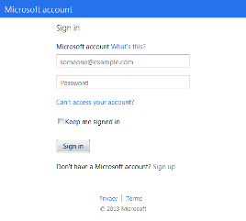

How Microsoft Azure Backup works
1. Sign up
2. Install agent
3. Register and configure
4. Back up encrypted data
Window Server 2012
5. Recover to the same or a different server

Slide 53
DEMO
Microsoft Azure Backup
Notes:
Demo Objective: Step through the process of using Microsoft Azure Storage by provisioning a Microsoft Azure Backup Vault, Registering a Backup Agent, and performing a Backup/Restore
Install: http://technet.microsoft.com/en-us/library/hh831761.aspx
Register Server: http://technet.microsoft.com/en-us/library/hh831677.aspx
Backup: http://technet.microsoft.com/en-us/library/hh831719.aspx
Recover: http://technet.microsoft.com/en-us/library/hh831344.aspx
Additional Information:
You can download the makecert.exe tool at http://aka.ms/makecert
Be sure to run makecert from an Administrator command prompt window – otherwise the new certificates will not be added to your Local Computer certificate store properly.
Demo Alternative:
Use demomate as alternative to live demo –
2.4 Working with Windows Server Backup to Azure
Available at http://aka.ms/HybridITCamps

Slide 54
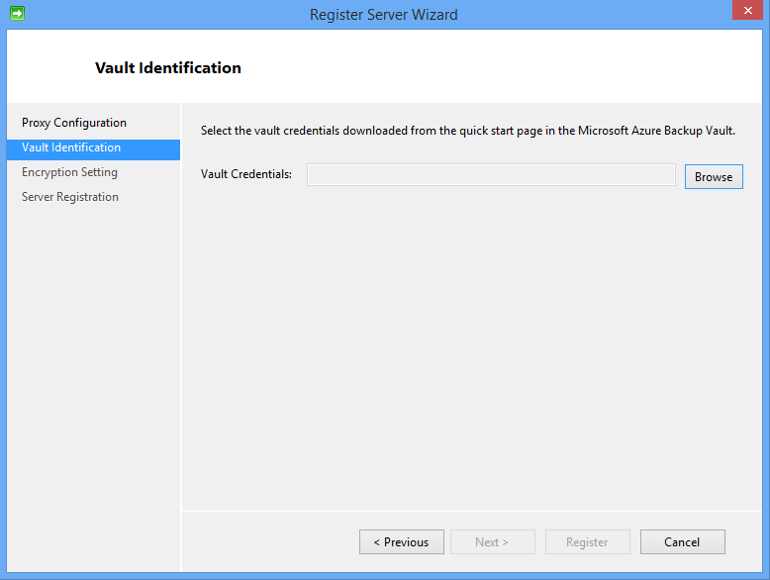
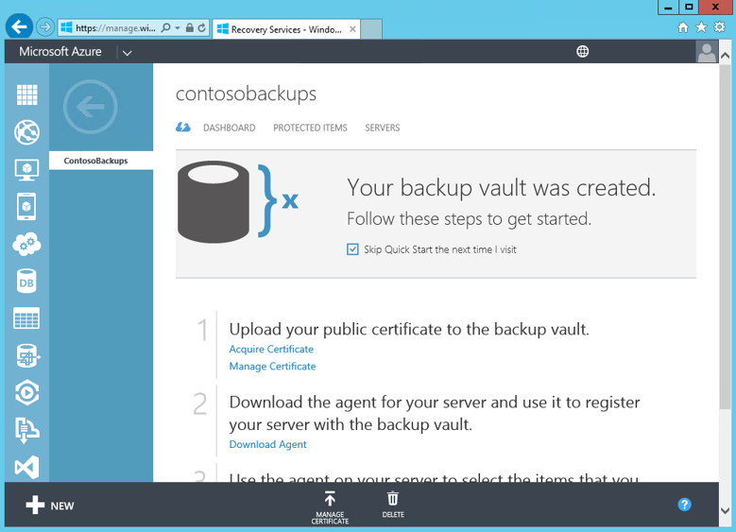
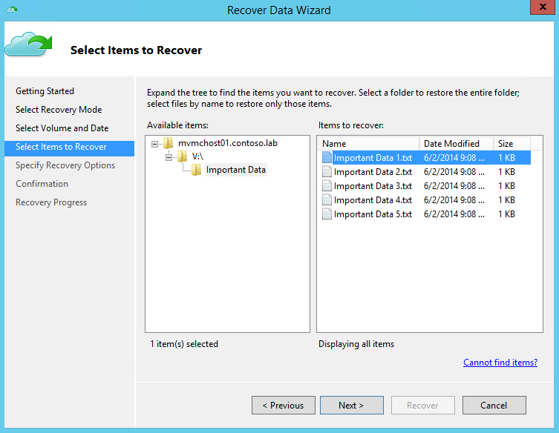
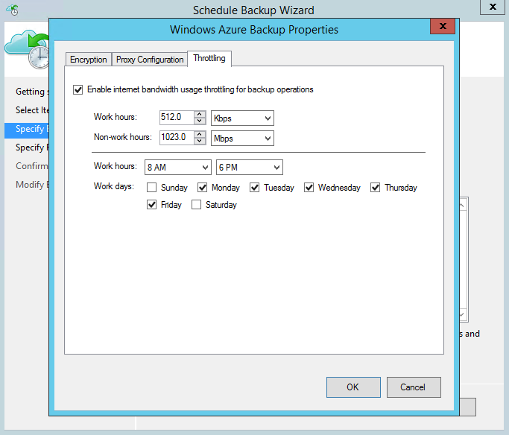
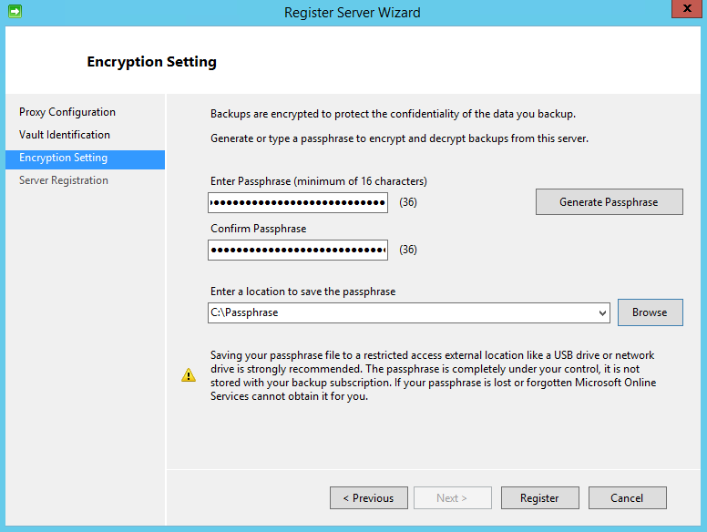
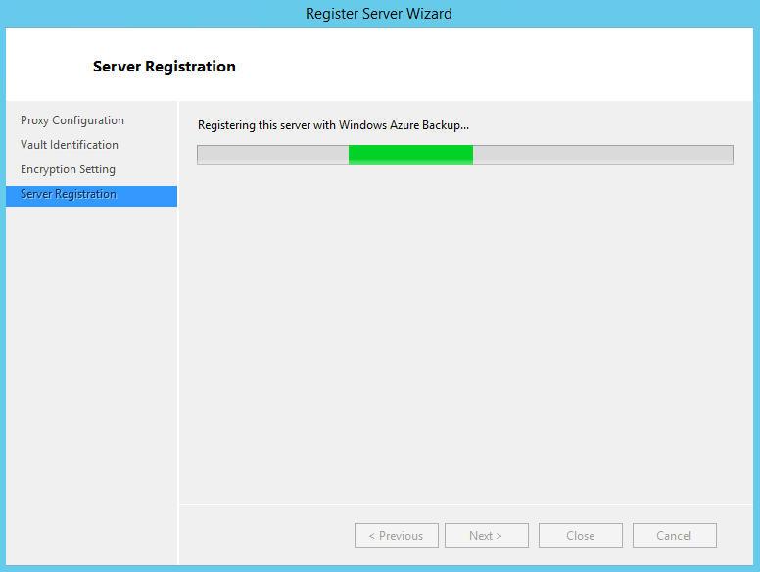
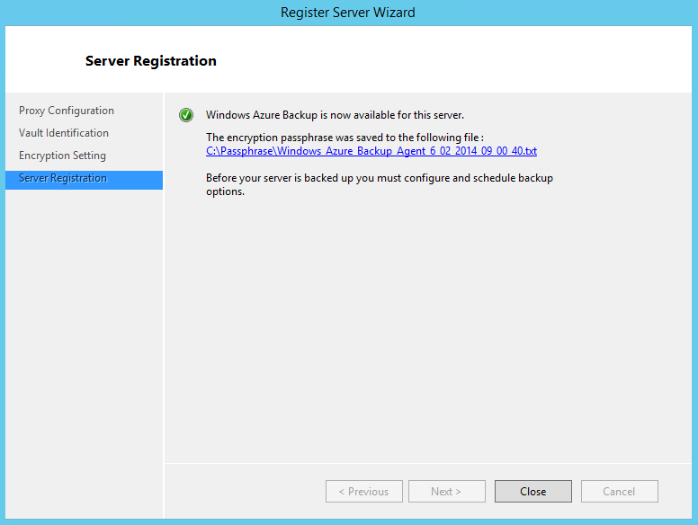
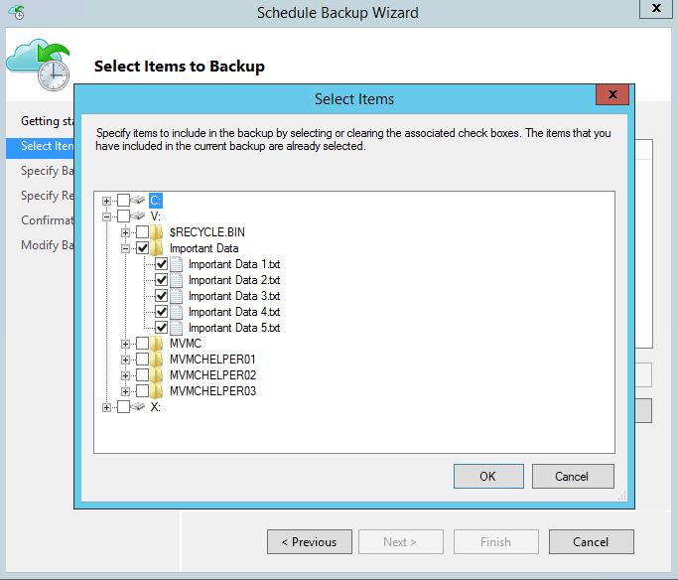
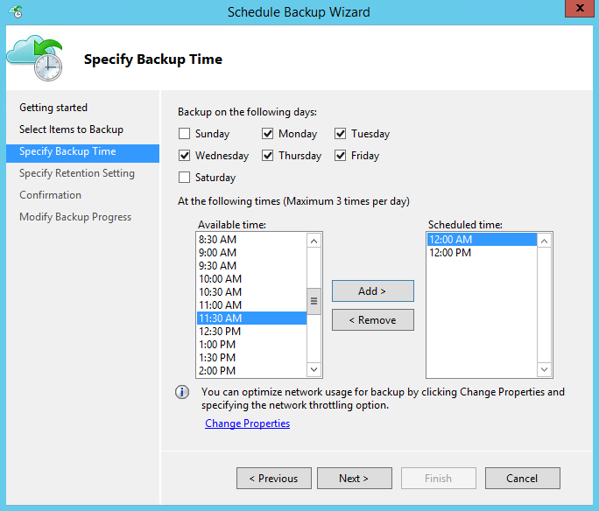
Microsoft Azure Backup Simplified, streamlined setup and integration
Getting started: Quick, streamlined sign up process followed by downloading appropriate vault credentials from Azure.
Download vault credentials onto servers you wish to register with Microsoft Azure Backup
Deployment and configuration: Simple agent installation onto target Windows Server instances followed by a straightforward server registration wizard.
Integrated with Windows Server Backup GUI: Streamlined wizard to protect important data to Microsoft Azure.
Flexible backup scheduling, with network optimization options.
Easy-to-use Recover Data Wizard to recover data quickly, and easily.
Notes:
Once a customer has completed the appropriate registration, the Microsoft Azure Backup agent is installed on the target server, which provides both the MMC interface and PowerShell interface for management. Once configuration is completed, the administrator can quickly and easily register the target server, and define the backup schedule, along with which files and folders to protect.
Microsoft Azure Backup is a very valuable addition to a local backup policy. It would allow a customer to recover data in case of disasters (server destroyed/stolen, disk crash), or alternatively, recover data in case of data loss scenarios such as data accidentally deleted, volume deleted, viruses. It also serves as a valid low-cost alternative to long-term tape archiving.
There are a number of target segments that Microsoft Azure Backup is aimed at:
Small Business: Low-cost backup & recovery solution for single server backups.
Departmental Backups: Low-cost backup alternative for departments in mid to large sized organizations
Remote office backup and recovery consolidation: Consolidate backups of remote offices

Slide 55
Summary: Azure Backup
Business Continuity Planning
Incident Response
Disaster Recovery
Application Lifecycle
Simple and reliable server backup to the cloud
Reliable offsite data protection
A simple and integrated solution
Efficient backup and recovery
Convenient offsite protection.
Safe data – geo-replication.
Encrypted backups.
Familiar interface.
Windows Azure integration.
Efficient use of bandwidth and storage.
Flexible configuration.
Flexibility in recovery.
Cost-effective and metered by usage.
Notes:
Slide Objective: Introduce Microsoft Azure Backup
Key Talking Points:
Microsoft Azure Backup helps protect server data against loss and corruption by enabling backup to offsite cloud storage in Microsoft Azure.
The service delivers on three key values – reliable offsite data protection, a simple and integrated solution, and efficient backup and recovery. Let’s look at each of these in turn.
Reliable offsite data protection
Convenient offsite protection: Local backups leave data vulnerable to unfortunate events such as fire. Continuously migrating backup media offsite can be inconvenient. Microsoft Azure Backup provides convenient, automated offsite data protection that stores data safely away from your premises, reducing the need to secure and protect onsite backup media.
Safe data: Data stored in Microsoft Azure is geo-replicated among Microsoft Azure data centers, for additional protection.
Encrypted backups: Your data is encrypted before it leaves your premises, and remains encrypted in Microsoft Azure – only you have the key.
A simple and integrated solution
Familiar interface: Small businesses protecting a single or few servers, can use familiar Windows Server in-box backup tools to protect data, manually or on a regular, automated schedule. Larger organizations with System Center 2012 can use the Data Protection Manager component to centrally manage backups across multiple servers.
Microsoft Azure integration: Microsoft Azure Backup is fully integrated with the Azure Management Portal for sign-up, billing, and web-based management.
Efficient backup and recovery
Efficient use of bandwidth and storage: Microsoft Azure Backup conserves WAN bandwidth and Microsoft Azure storage by sending only changes to files with incremental backups.
Flexible configuration: Configurable data retention policies, data compression, and data transfer throttling provide for both flexible backup policies and backup efficiency.
Flexibility in recovery: Incremental backups enable point-in-time recovery of multiple versions of the data. Plus, you can recover just what you need with file-level recovery.
Cost-effective: Microsoft Azure Backup helps you control costs by reducing the need for local storage and offsite media management, while benefiting from simple storage-based pricing with no per-server or data transfer fees.

Slide 56

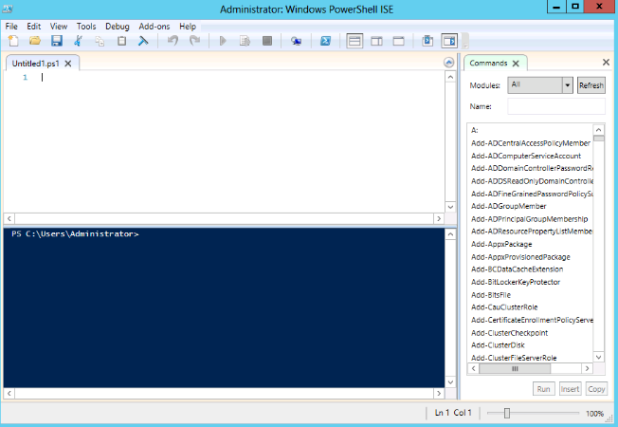
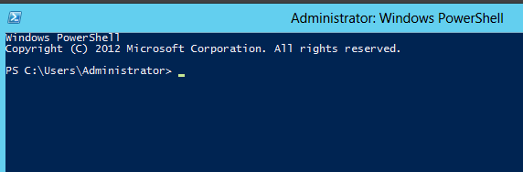
What is Windows PowerShell?
Windows PowerShell is a distributed automation engine with a scripting language and interactive shell(s)
It’s a Command Line Shell
It’s a Scripting environment & language
Bridges the gap between operators and developers
Extend management capabilities

Slide 57
What’s so great about PowerShell?
The preferred way to manage in Windows
Use to Automate Everything!!!
Built on .Net
Objects – not just text
The power behind Server Manager
Integrated Scripting Environment (ISE)

Slide 58
PowerShell Basics
Uses Verb-Noun Syntax
Command line from any of the various Management Shells
ISE if you are writing scripts, or just exploring
Modules can be loaded for the product you want to work with
PowerShell works with objects – not text (see demo)
Pipelines allow passing of these objects, and also control looping with no need to hard code

Slide 59
Microsoft Azure online backup cmdlets
To list all the cmdlets that are available, use Get-Command -Module MSOnlineBackup cmdlet. {OB = Online Backup}
Add-OBFileSpec | Get-OBRecoverableSource | Remove-OBPolicy
Get-OBAllRecoveryPoints | Get-OBRetentionPolicy | Rename-OBVolume
Get-OBAlternateBackupServer | Get-OBSchedule | Set-OBMachineSetting
Get-OBFileSpec | New-OBFileSpec | Set-OBPolicy
Get-OBJob | New-OBPagingContext | Set-OBPolicyState
Get-OBMachineSetting | New-OBPolicy | Set-OBRetentionPolicy
Get-OBMachineUsage | New-OBRecoverableItem | Set-OBSchedule
Get-OBNotification | New-OBRecoveryOption | Start-OBBackup
Get-OBPolicy | New-OBRetentionPolicy | Start-OBRecovery
Get-OBPolicyState | New-OBSchedule | Start-OBRegistration
Get-OBRecoverableItem | Remove-OBFileSpec | Stop-OBJob
Notes:
http://technet.microsoft.com/en-us/library/hh770400.aspx

Slide 60
Azure & PowerShell Getting Started
Download PowerShell Module
http://azure.microsoft.com/en-us/downloads/ (uses Web Platform Installer)
Authenticate with Azure
What Accounts are connected: Get-AzureAccount
Connect to Azure Account: Add-AzureAccount
Remove Azure Account: Remove-AzureAccount <ID>
Test Authentication: Get-AzureVM or any command that connects to azure
Azure Subscriptions
List Subscriptions: Get-AzureSubscription
Set Default Subscription: Set-AzureSubscription “Subscription Name”

Slide 61
DEMO
Azure PowerShell
Notes:
Demo Objective: Step through the process of using Microsoft Azure Storage by provisioning a Microsoft Azure Backup Vault, Registering a Backup Agent, and performing a Backup/Restore
Install: http://technet.microsoft.com/en-us/library/hh831761.aspx
Register Server: http://technet.microsoft.com/en-us/library/hh831677.aspx
Backup: http://technet.microsoft.com/en-us/library/hh831719.aspx
Recover: http://technet.microsoft.com/en-us/library/hh831344.aspx
Additional Information:
You can download the makecert.exe tool at http://aka.ms/makecert
Be sure to run makecert from an Administrator command prompt window – otherwise the new certificates will not be added to your Local Computer certificate store properly.
Demo Alternative:
Use demomate as alternative to live demo –
2.4 Working with Windows Server Backup to Azure
Available at http://aka.ms/HybridITCamps

Slide 62
















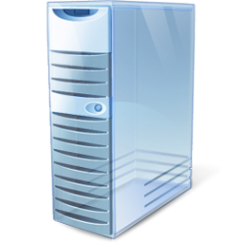

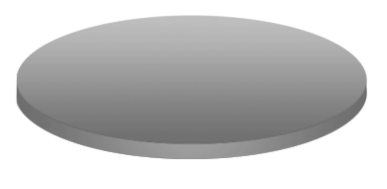
















System Center Data Protection Manager - Overview
Active Directory
Disk-based
Recovery
Windows Azure Online Backup Service
File Services
Up to
Every 15 minutes
Tape-based
Backup
Data Protection Manager
Disaster Recovery
with offsite replication & tape
Client

Slide 63




DPM backup to Azure
A simple, secure and cost effective “offsite” data backup and recovery service for System Center customers.
Simple & Easy to manage - Seamless & simple workflows integrated into existing DPM workflows Flexibility in local and online backup policy configuration: Retention range Backup schedule Data source selection
Peace of mind: server backups in the cloud - Highly reliable Windows Azure Online Backup Service Microsoft Azure based service offers redundancy & high availability Data encrypted over the wire and at rest , using customer supplied passphrase Verification of data integrity in the cloud
Cost Effective & Efficient -
Public cloud based service and storage enables: Elasticity Scalability Simplified Storage management
Efficient cloud backup solution: Block-level incremental back ups to reduce storage & b/w utilization Data compression Bandwidth throttling
Efficient, secure backup
DPM
Windows Azure Online Backup Service
On Prem Datacenter
Simple recovery
Notes:
For a single 100GB VM it roughly take 30 hrs for 7.6 Mbps upload link.
For a single 100GB VM it roughly take 9 hrs for 25 Mbps upload link.

Slide 64
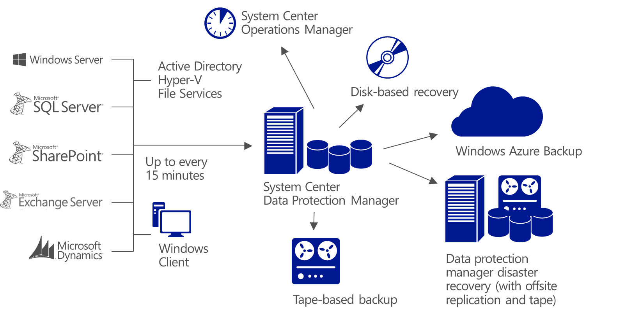
Data Protection Manager
Centralized protection for Hybrid Cloud workloads
Workloads – DPM protects key workloads, at a granular application level, up to every 15 minutes.
Disk/Tape – DPM supports protecting short-term to disk, and long-term to tape.
Centralized – With integration with OpsMgr, the central console enables management of all DPM servers from a single location.
Azure Integration – DPM now supports archiving data up to Windows Azure
Low-Cost DR – DPM on site 1, can be protected by DPM on another site, for DR purposes.
Scalable – 800 VMs per DPM server, parallel backups, page-file exclusion, Live Migration support
Notes:
Slide Objective: Introduce System Center 2012 R2 Data Protection Manager for Hybrid Cloud Protection.
Key Talking Points:
Data Protection Manager has been within the System Center family since the 2006 version was launched, and since then, has continued to evolve with more and more enhanced capabilities around backup and workload protection. With the 2012 R2 release, there have been further incremental improvements in DPM, that make it an excellent companion for Hyper-V, offering granular, efficient protection of VMs
Let’s first look at what DPM can provide for our infrastructure.
Firstly, DPM is focused on protecting a significant number of different workloads, such as the latest versions of Exchange, SQL Server, SharePoint, and more specifically for this course, Hyper-V. Many of these workloads can be protected up to every 15 minutes.
It can be time-consuming to manage multiple servers in Microsoft System Center Data Protection Manager. You must move from one server to another to perform various management and maintenance tasks. However, with System Center 2012 SP1 Data Protection Manager (DPM), you can manage all your DPM servers from a single location.
After you have installed the Central Console on the Operations Manager server, and imported the DPM Management Pack, you can begin monitoring and managing your DPM servers centrally, from Operations Manager. You can track servers for DPM 2010, System Center 2012 DPM and System Center 2012 SP1 DPM in the Central Console.
The important features of the Central Console are:
Centralized monitoring of DPM servers across different versions of DPM
Remote administration
Role-based access control
Remote recovery
Remote corrective actions
Service level agreement (SLA)-based alerting: Alerts are generated only when an SLA is broken
Alert consolidation
Support for scripting repetitive DPM jobs
When you use the centralized management solution, you can monitor all your DPM servers from a single location. In the Central Console, you can monitor the health of the various DPM resources like DPM server, protected computers, tape libraries, available disk space, and more. The Central Console also tracks the various tasks inDPM, like whether recovery points are being taken at the scheduled times, or whether a server is still on the network.
In terms of backup repositories, with System Center 2012 – Data Protection Manager (DPM) data protection, you can use disk-based storage, tape-based storage, or both.
Disk-based storage, also called D2D, for "disk-to-disk," is a type of backup in which data from one computer is stored on the hard disk of another computer. This contrasts with the more traditional method of backing up data from one computer to a storage media such as tape, also called D2T, for "disk-to-tape." For extra protection, the two methods can be combined in a disk-to-disk-to-tape (D2D2T) configuration that provides the rapid recovery benefits of disk-based storage in the short term and tape-based, archive storage for critical data in the long term.
One advantage of disk-based data protection is the potential time savings. Disk-based data protection requires none of the preparation time that tape-based protection does—locating the specific tape required for a job, loading the tape, positioning the tape to the correct starting point. The ease of using a disk encourages sending incremental data more frequently, which reduces the impact on the computer being protected and on network resources.
Data recovery with disk-based data protection is more reliable than that of tape-based systems. Disk drives typically have a much greater mean time between failure (MTBF) rating than tapes.
Recovery of data from disk is quicker and easier than recovery from tape. Recovering data from disk is a simple matter of browsing through previous versions of the data on the DPM server and copying selected versions directly to the protected computer. A typical file recovery from tape takes hours and can be costly, and administrators in a medium-size data center can usually expect to perform 10 to 20 or more of these recoveries each month.
Using DPM and disk-based data protection, data can be synchronized as frequently as every 15 minutes and maintained as long as 448 days
Magnetic tape and similar storage media offer an inexpensive and portable form of data protection that is particularly useful for long-term storage.
In DPM, you can back up data from a computer directly to tape (D2T). You can also back up data from the disk-based replica (D2D2T). The advantage of creating your long-term backup on tape from the disk-based replica is that the backup operation can occur at any time with no impact on the computer being protected.
Additionally, a thorough disaster recovery plan includes offsite storage of critical information—you want to be able to recover your organization's data, should your facility be damaged or destroyed. Tape is a popular and convenient medium for offsite storage.
Using DPM, data can be backed up to tape as frequently as daily for short-term protection, and it can be maintained as long as 99 years for long-term protection.
Apart from this, software solutions from DPM partners allow you to use removable media such as a USB hard drive in place of tape
With System Center 2012 SP1, DPM can backup data from the DPM server to an offsite storage that is managed by the Windows Azure Online Backup Service.
System Center customers can benefit from this functionality by signing up for the Windows Azure Online Backup service. Customers will need to download and install the Windows Azure Online Backup agent on the DPM server, which will be used to transfer the data between the DPM server(s) and Windows Azure Online Backup service.
With the new online backup capabilities in DPM customers will see the following benefits:
Reduced TCO: The Windows Azure Online Backup service can help to reduce the total cost of ownership (TCO) for customers by providing scalability, elasticity, and simplified storage management.
Peace of mind: The Windows Azure Online Backup service provides a reliable, secure, and a robust offsite backup and restore solution that is highly available.
Simplicity: The Windows Azure Online Backup workflows are seamlessly integrated into the existing DPM backup, recovery and monitoring workflows
The following scenarios are supported when protecting data using Windows Azure Online Backup.
DPM server must be on Windows Server 2012.
Protection for file system
Protection for virtual machines
Protection for SQL Server databases
Supported file types
Encrypted (Full backups only)
Compressed (Incremental backups supported)
Sparse (Incremental backups supported.
Compressed and sparse (Treated as Sparse)
Finally, System Center 2012 – Data Protection Manager (DPM) enables you to protect your data sources on a secondary DPM server, preferably at a remote location, as a backup to your primary DPM server for disaster recovery. A disaster can take the following forms:
The primary DPM server and the protected computers are lost.
Only the primary DPM server is lost.
In the first case, having a secondary DPM server in a remote location enables you to recover your protected computers quickly. In the second case, you can switch protection so that the secondary DPM server takes over as the primary DPM server for the protected computers until another computer can be set up as the primary DPM server.
So, how does DPM protect virtual machines?
Firstly, DPM utilizes a capability known as Express Full Backups. An express full backup is a type of synchronization in which the protection agent transfers a snapshot of all blocks that have changed since the previous express full backup (also since the most recent consistency check performed or the initial replica creation for the first express full backup) and updates the replica to include the changed blocks. The impact of an express full backup operation on performance and time is expected to be less than the impact of a full backup because System Center 2012 – Data Protection Manager (DPM) transfers only the blocks changed since the last express full backup.
The express full backup uses DPM filter technology to identify the changed blocks instead of requiring DPM to read all the data or use checksums. This reduces the performance load on the protected computer significantly.
This process is now cluster aware, and integrates deeply with Cluster Shared Volumes, meaning backups can be performed in parallel, and when compared with protecting Virtual Machines on prior versions of Cluster Shared Volumes, the process has been accelerated so much that performance has increased by 900%.
Scalability & performance of DPM have both been optimized, with supported limits being increased for DPM to support up to 800 virtual machines from a single DPM server, and in addition, DPM now supports the exclusion of page files from backups. This gives you the benefit of reduced storage requirement and improvement in backup performance.
Finally, with Windows Server 2012 supporting SMB shares for Hyper-V virtual machines, DPM also has awareness of this and will continue to protect your virtual machines that are stored on the remote SMB shares.
Windows Server 2012 supports various scenarios for Hyper-V Live Migration, such as inter-cluster migration, intra-cluster migration, migration from stand-alone to clustered computers, migration from clustered to stand-alone computers, and migration between stand-alone computers. DPM supports protection for all these scenarios even when they use remote SMB shares. DPM communicates to the Virtual Machine Manager (VMM) server to keep track of the computer on which the virtual machine is when the backup is to be performed.
DPM will continue to do express full backup for all virtual machine Live Migrations with no storage migration
Finally, as discussed earlier, Customers can utilize DPM and Windows Azure to provide offsite, long-term storage for data.
With System Center 2012 SP1, DPM can backup data from the DPM server to an offsite storage that is managed by the Windows Azure Online Backup Service.
System Center customers can benefit from this functionality by signing up for the Windows Azure Online Backup service. Customers will need to download and install the Windows Azure Online Backup agent on the DPM server, which will be used to transfer the VM data between the DPM server(s) and Windows Azure Online Backup service.
With the new online backup capabilities in DPM customers will see the following benefits:
Reduced TCO: The Windows Azure Online Backup service can help to reduce the total cost of ownership (TCO) for customers by providing scalability, elasticity, and simplified storage management.
Peace of mind: The Windows Azure Online Backup service provides a reliable, secure, and a robust offsite backup and restore solution that is highly available.
Simplicity: The Windows Azure Online Backup workflows are seamlessly integrated into the existing DPM backup, recovery and monitoring workflows
So we’ve heard quite a bit about DPM, but let’s take a look at it in more detail through a demo.
<next slide>

Slide 65
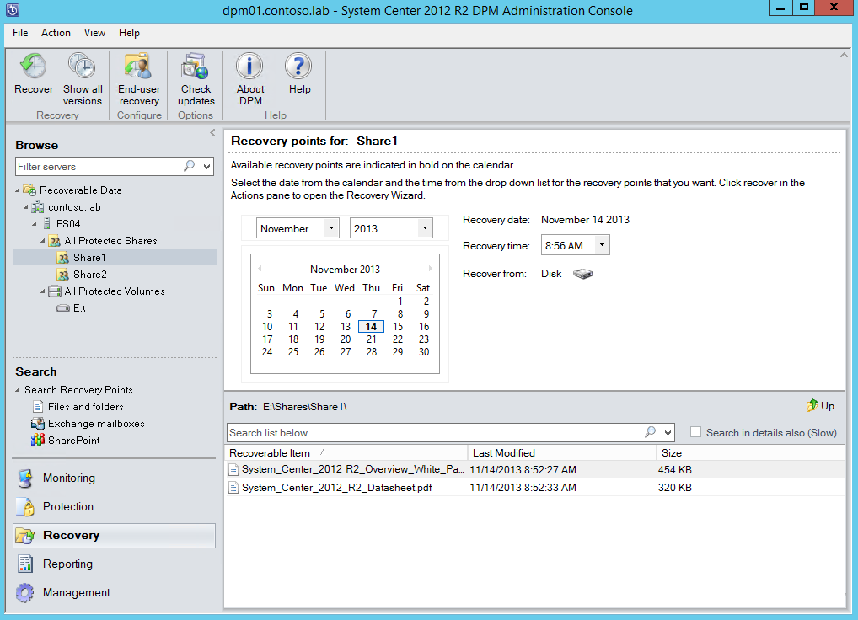
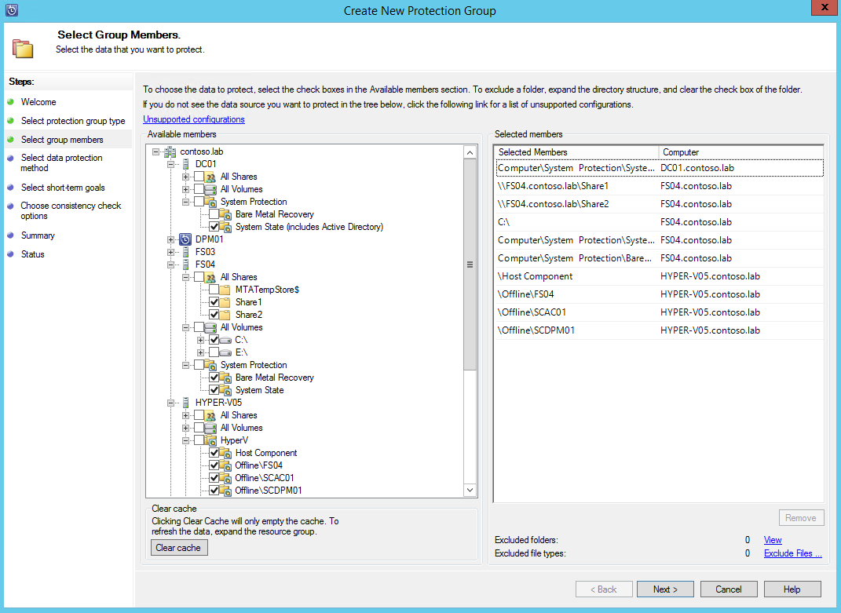
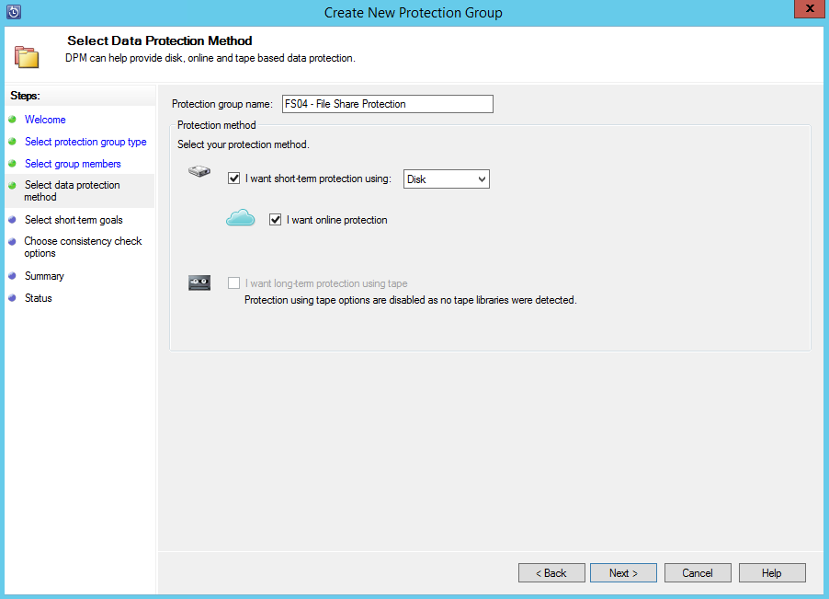
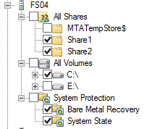
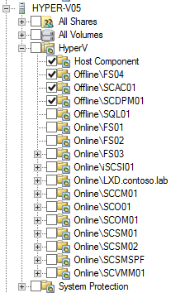
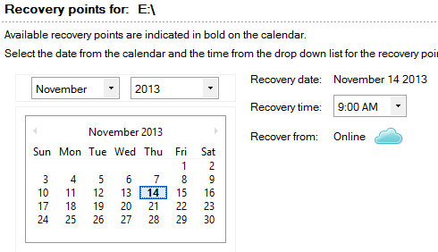
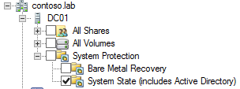
Windows Server protection End-to-end protection for Windows Server data and key roles
Centralized Windows Server backup: Administrators define Protection Groups—collection of data sources, such as volumes, shares, or app-specific data, which have a common protection configuration.
Protect Windows Servers at multiple levels— file shares, volumes and folders, as often as every 15 minutes.
Supports protection of system state and provides bare metal recovery.
Provides granular protection of Domain Controller, File Server, and Hyper-V roles.
Offers protection to disk and tape, and integration with Microsoft Azure Backup enables offsite, cloud protection.
Supports item-level recovery to original or alternative locations, even from Microsoft Azure Backup.
Notes:
System Center 2012 R2 provides centralized protection against data loss and corruption through Data Protection Manager. DPM provides granular protection for Windows Server, along with a number of other Microsoft workloads, such as Exchange, SQL, SharePoint and Hyper-V.
Firstly, the administrator defines a protection group. A protection group is a collection of data sources, such as volumes, shares, or Exchange Server storage groups, which have a common protection configuration. Data sources within a protection group are referred to as protection group members or simply members. The protection group configuration encapsulates the data backup targets (disk or tape), the protection schedule that specifies how often to synchronize the replica with the live data on the protected computer, and when to create recovery points of the replica and the performance options that you want to enable such as on-the-wire compression and daily consistency checks.
Some of the factors you should consider when deciding how to organize your data into protection groups are the business requirements of your organization, network performance, and the characteristics of the data. Consider, for example, how often the data changes, how rapidly the data size increases, and how critical it is to be able to recover a very recent copy of lost data. You might also want to consider how frequently you need to back up the data to tape, which data needs to be encrypted or compressed, and the number of backup copies you need available. In most cases, you will want to group data with similar characteristics together.
From a Windows Server perspective, DPM protects key elements of the Windows Server OS itself, such as the System State. System state is a collection of system-specific data maintained by the operating system that must be backed up as a unit. It is not a backup of the entire system. The backup of a computer's system state can be used when you need to return the computer to a known state, such as after an installation that puts the computer in an undesirable state.
System State is protected with specific information depending on the roles installed on the target server. Member Servers, Domain Controllers, Certificate Servers, and Clustered Servers will all have unique information or metadata protected as part of the System State backup. In addition, folders, file shares and full volumes can be protected on target Windows Servers.
DPM also provides support for Bare Metal Recovery of servers. Bare metal recovery is the process of rebuilding a computer after a catastrophic failure. DPM backs up the system volume and master boot record by copying the entire volume and using VSS writers to ensure that all applications are in a consistent state for the copy.
DPM protects your systems by periodically recording snapshots of your servers and workstations. These snapshots, called recovery points, enable DPM to repair or roll back systems to previous stable states, even if the systems have become unbootable.
DPM supports not only protecting data for short term retention to disk, but also longer term retention to tape, and with the integration with Microsoft Azure Backup, now to the cloud. Should data loss on production systems occur, DPM can quickly and easily recover the data, down to the individual document, even from Microsoft Azure.

Slide 66

Hyper-V virtual machine protection Granular end-to-end protection at private cloud scale
Flexible configurations and enterprise-class scalability: DPM supports protection of VMs that reside on cluster-shared volumes and those accessed through SMB 3.0.
Each DPM server protects up to 800 VMs, each with 100GB storage per server with minimal impact on the production environment.
Now includes additional flexibility through a new backup window for VM data sources.
Hyper-V VSS integration: works seamlessly with Hyper-V VSS writer to ensure that consistent versions of VMs are captured and protected without downtime.
Live migration awareness: provides full support for VMs that are migrated around the infrastructure, automatically detecting live migrations and optimizing backups.
CSV on Block Storage (iSCSI or FC)
Windows Server Scale-Out File Server
Enhanced Linux protection: provides online, file-consistent protection of Linux virtual machines on Hyper-V.
Notes:
System Center 2012 Service Pack 1 and subsequently, R2, provide a number of new features to improve the DPM backup experience of servers that run Hyper-V and host virtual machines:
Flexible Configurations
Improvements for backup of virtual machines by using Cluster Shared Volume (CSV) storage:
Support for Cluster Shared Volumes (CSV) 2.0 that results in a 90 percent improvement in the performance by extending the express full backup to CSV clusters and improved cluster query performance.
Parallel backups are supported. This feature eliminates the requirement to disable parallel backup and serialize the guests on multiple CSVs.
No performance difference between backups from CSV owner and non-owner nodes.
Improvements for backup of virtual machines by using SMB 3.0 storage—Windows Server 2012 and R2 supports the use of server message block (SMB) 3.0 file shares as remote storage, which allows Hyper-V to store configuration files, virtual hard disk (VHD) files, and snapshots on SMB file shares. SMB support provides the following benefits for DPM backup:
More efficient express full backups.
Continued protection even after live migration.
Support for SMB shares on a stand-alone file server or on a cluster of file servers.
Improvements in Scalability:
Scalability & performance of DPM have both been optimized, with supported limits being increased for DPM to support up to 800 virtual machines from a single DPM server (each 100GB in size), and in addition, DPM now supports the exclusion of page files from backups. This gives you the benefit of reduced storage requirement and improvement in backup performance.
Hyper-V VSS Integration
DPM works seamlessly with Hyper-V VSS writer to ensure that consistent versions of virtual machines are captured and protected without affecting virtual machine access. The ability to back up open files is critical for business continuity, and Volume Shadow Copy Services (VSS) is a technology that creates frozen copies of open files. It ensures that virtual machines do not have to be put into hibernation or be shut down before a consistent backup can be made. VSS, DPM, and Hyper-V interact as follows:
The DPM block-based synchronization engine makes an initial copy of the protected virtual machine and ensures that the copy of the virtual machine is complete and consistent.
After the initial copy is made and verified, DPM captures backups by using the Hyper-V VSS writer. The VSS writer provides a data-consistent set of disk blocks that are synchronized with the DPM server. This approach provides the benefit of a "full backup" with the DPM server while it minimizes the amount of backup data that have to be transferred across the network.
The DPM protection agent on a server that is running Hyper-V uses the existing Hyper-V APIs to determine whether a protected virtual machine also supports VSS.
If a virtual machine is running guest operating systems beginning with Windows Server 2003, and has the Hyper-V integration services component installed, then the Hyper-V VSS writer recursively forwards the VSS request through to all VSS-aware processes on the virtual machine. This operation occurs without the DPM protection agent being installed on the virtual machine. This recursive VSS request allows the Hyper-V VSS writer to ensure that disk write operations are synchronized so that a VSS snapshot is captured without the loss of data.
The Hyper-V integration services component invokes the Hyper-V VSS writer in Volume Shadow Copy Services (VSS) on virtual machines to ensure that their application data is in a consistent state.
If the virtual machine does not support VSS, then DPM automatically uses the Hyper-V APIs to pause the virtual machine before they capture data files.
After the initial baseline copy of the virtual machine synchronizes with the DPM server, all changes that are made to the virtual machine resources are captured in a new recovery point. The recovery point represents the consistent state of the virtual machine at a specific time. Recovery point captures can occur at least one time a day. When a new recovery point is created, DPM uses block-level replication in conjunction with the Hyper-V VSS writer to determine which blocks have been altered on the server that is running Hyper-V after the last recovery point was created. These data blocks are then transferred to the DPM server and are applied to the replica of the protected data.
The DPM server uses VSS on the volumes that host recovery data so that multiple shadow copies are available. Each of these shadow copies provides a separate recovery. VSS recovery points are stored on the DPM server. The temporary copy that is made on the server that is running Hyper-V is only stored for the duration of the DPM synchronization.
In addition to protecting individual virtual machines that are hosted on a server that is running Hyper-V, DPM can also protect workloads that run on a virtual machine for an extra level of protection. This process is the only way in which you can protect data that is stored on pass-through disks. Pass-through disks allow the virtual machine direct access to the storage device and do not store virtual volume data within a VHD file
Live Migration Awareness
You can move virtual machines from one location to another while the virtual machines sustain connections and with no noticeable drop time-based on these improvements, live migration provides uninterrupted data protection. Live migration can transfer virtual machines between two stand-alone servers, within a cluster or between stand-alone and cluster nodes. DPM can be used to back up data of virtual machines that are configured for live migration. Migration is often performed independently of backup procedures and can lead to backup failures if not coordinated. DPM addresses this issue by detecting live migration of virtual machines and automatically optimizing backups.
When a virtual machine is migrated within a cluster, DPM detects the migration, and backs up the virtual machine from the new cluster node without any requirement for user intervention. Because the storage location has not changed, DPM continues with express full backups. In a scaled scenario with two DPM servers to protect the cluster, a virtual machine that is protected by DPM1 continues to be protected by DPM1, no matter where the virtual machine is migrated.
When a virtual machine is migrated between stand-alone servers, different clusters, or between a stand-alone server and a cluster, DPM detects the migration, and can back up the virtual machine without user intervention
So, how does DPM protect virtual machines?
Firstly, DPM utilizes a capability known as Express Full Backups. An express full backup is a type of synchronization in which the protection agent transfers a snapshot of all blocks that have changed since the previous express full backup (also since the most recent consistency check performed or the initial replica creation for the first express full backup) and updates the replica to include the changed blocks. The impact of an express full backup operation on performance and time is expected to be less than the impact of a full backup because System Center 2012 – Data Protection Manager (DPM) transfers only the blocks changed since the last express full backup.
The express full backup uses DPM filter technology to identify the changed blocks instead of requiring DPM to read all the data or use checksums. This reduces the performance load on the protected computer significantly.
Enhanced Linux Protection
DPM provides support for the protection and backup of Linux virtual machines, in addition to the support already provided for Hyper-V virtual machines. Note that for Linux backups only file-consistent snapshots are supported. Application-consistent snapshots are not. In addition, protection of Linux virtual machines is not supported using Microsoft Azure Backup.
<next slide>

Slide 67
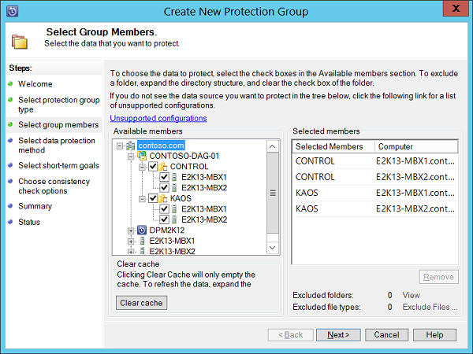
Exchange protection Granular end-to-end application protection
Integrated backup for Exchange: Through System Center Data Protection Manager, IT administrators can protect Exchange at both the VM and Exchange levels.
Integrates with Exchange VSS writer and provides the ability to protect Exchange data, as often as every 15 minutes to disk, and on to tape.
Enables recovery at the mailbox database, and when combined with Exchange PowerShell, also the mailbox level.
Provides automatic protection of new mailboxes within a protection group.
Supports protection of highly available Exchange deployments such as CCR, SCR and DAG and compliments Exchange’s built-in native protection.
Each DPM server can protect up to 20 DAG nodes, or 10,000 mailboxes, with up to 344,000 recovery points.
Notes:
With Data Protection Manager, Microsoft provide a solution to protect key Exchange Servers, along with SharePoint, SQL Servers, and Hyper-V VMs, along with the core Windows Server OS, all from the same single agent. When running Exchange inside a Hyper-V virtual machine, not only can the administrator protect data at the VM level, working with both the Hyper-V and Exchange VSS writers to coordinate the backup, but additionally, IT administrators can place an agent inside the Exchange VMs and gain a more granular, centralized level of backup for the Exchange Servers too.
DPM uses a combination of transaction log replication and block-level synchronization in conjunction with the Exchange VSS Writer to help ensure your ability to recover mailbox databases (not the individual mailboxes). After the initial baseline copy of data, two parallel processes enable continuous data protection with integrity:
Transaction logs are continuously synchronized to the DPM server, as often as every 15 minutes.
An “express full” uses the Exchange Server VSS Writer to identify which blocks have changed in the entire production database, and send just the updated blocks or fragments. This provides a complete and consistent image of the data files on the DPM server. DPM maintains up to 512 shadow copies of the full Exchange Server database(s) by storing only the differences between any two images.
Assuming one “express full” per week, stored as one of 512 shadow copy differentials between one week and the next, plus 7 days x 24 hours x 4 (every fifteen minutes), DPM provides over 344,000 data consistent recovery points for Exchange.
Exchange Server includes native data protection, a set of features that, when deployed and configured correctly, can eliminate the need to make traditional backups of your data. Although the Exchange built-in native data protection can be enough for some organizations, there are situations where traditional backup still makes sense. And this is where DPM 2012 can help, since it was designed to provide specific protection for Exchange Server and other Microsoft workloads. DPM provides continuous data protection for Exchange Server 2007, 2010 and 2013, through disk-to-disk, disk-to-tape technologies. DPM supports backing up standalone mailbox databases, active and passive databases in a Database Availability Group (DAG) in Exchange 2010 and 2013, as well as continuous replication (LCR, CCR and SCR) in Exchange 2007.
As previously stated, Exchange 2013 (and also 2010) include a set of features that can provide native data protection. A backupless strategy using only Exchange built-in features requires you to keep at least 3 copies of the databases, being one of these copies, preferably, a lagged copy.
Exchange 2013 Native Data Protection is particular efficient and cost-effective for the following scenarios:
Disaster Recovery
Recovery of accidentally deleted items
Long-term data storage
Point-in-time database snapshot
Nevertheless, there are some situations where Exchange native protection mechanisms might not be enough, such as:
Application errors
Logical corruption
Security breaches
Malware
These are some of the benefits of implementing DPM in conjunction with DAGs:
Less complicated point-in-time (PIT) restoration – DPM allows administrators to perform PIT recovery with several quick selections from an intuitive GUI interface, minimizing the complexity and time required for a restoration.
Fewer Exchange servers needed - Leveraging DAGs to provide a comprehensive data protection solution requires that you deploy a minimum of three Exchange mailbox servers: one to host the active mailbox database, one to host the up-to-date copy, and one to host the lagged copy.
If you are attempting to also provide offsite backup and recovery, even more Exchange mailbox servers are required. With a DPM solution in place, offsite backup and PIT restores can be handled through DPM with DAGs implemented primarily as a high availability solution.
Longer retention range - By design, PIT recovery from a lagged recovery is limited to a maximum of 14 days. DPM enhances the data protection available to administrators by providing PIT restore from outside the 14-day limitation.
More consistent backup and recovery process - DPM allows an organization to use a consistent backup and recovery process across multiple workloads such as File servers, SQL, Hyper-V, and SharePoint
Adding mailbox databases to the server. If you create or add new mailbox databases to a protected storage group on an Exchange Server computer, these databases will be automatically added to the DPM replication and protection. Incremental backups will fail until a full backup is completed
DPM limits. With DPM, the maximum amount of data that you can protect with a single DPM server is 80 TB. Therefore you can protect DAG’s that have up to 20 nodes with a single server or up to 10,000 mailboxes with a DPM server.
DPM 2012 supports recovery of the following Exchange data:
An entire storage group (Exchange 2007 or lower).
A single mailbox database.
A single mailbox.
Depending on the type of information to recover, you also have some flexible restore options where to dump the data:
To its original location.
To a Recovery Storage Group / Recovery Database.
To a separate network folder.
To a tape drive.
Besides all the discrete recovery points that are available (and they can be every 15 minutes), DPM provides one more recovery capability: to recover “latest”, resulting in near zero data loss when the recovery is complete. In the event of a complete loss of the Exchange database files, one can choose “latest” which instructs DPM to first restore to the last recovery point and then roll forward the surviving transaction logs beyond that, as long as the best practice of storing Exchange databases on one volume and logs on another has been respected
DPM 2012 supports the recovery of individual mailboxes, although unlike other products that do brick-level backups, to recover a mailbox, DPM must copy the entire database, because this is the recommended method that Exchange supports
Data Protection Manager 2012 provides fully integrated data protection for Microsoft Exchange 2003, 2007, 2010 and 2013. When using DPM 2012 you can have confidence that:
DPM can be used to reliably and quickly back up Exchange production servers at frequent intervals without a strong impact on performance.
DPM replicas and recovery points allow organizations to reliably restore Exchange data not only in its most recently backed up state, but in any state that was captured in recovery points.
Exchange mailbox data can be restored not just to the original Exchange server, but to other protected servers and arbitrary file locations
By using combined disk-to-disk, disk-to-tape technologies, DPM helps to ensure that an Exchange infrastructure is better protected and always available

Slide 68
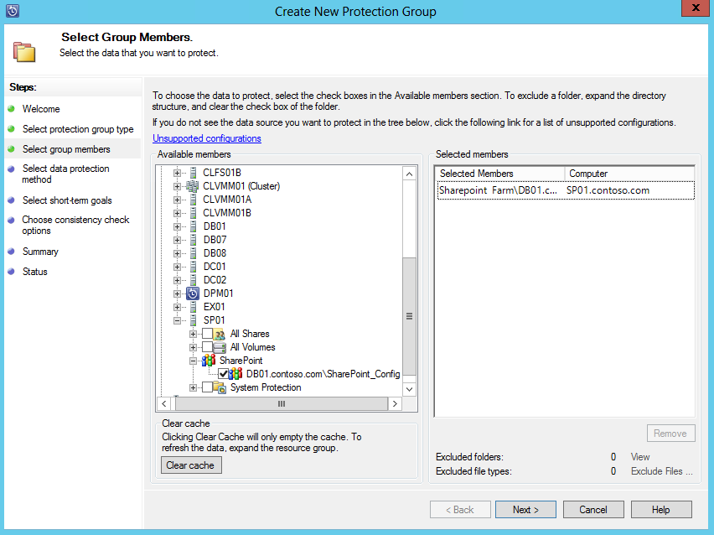
SharePoint protection Granular end-to-end application protection
Integrated, intelligent backup: Through System Center Data Protection Manager, IT administrators can protect SharePoint at both the VM and SharePoint levels.
Integrates with SharePoint VSS writer and provides the ability to protect SharePoint data, as often as every 30 minutes to disk, and on to tape or cloud.
Provides in-line, item level recovery, and restoration of configuration and central admin database and automatic protection of new content databases.
Reduced storage consumption when compared with native SharePoint backup capabilities.
Enables administrator for backup and restoration to be delegated to key stakeholders.
Each DPM server protects up to 25TB SharePoint data (tested soft limit).
Notes:
With Data Protection Manager, Microsoft provide a solution to protect key SharePoint data, along with Exchange, SQL Servers, and Hyper-V VMs, along with the core Windows Server OS, all from the same single agent. When running SharePoint inside a Hyper-V virtual machine, not only can the administrator protect at the VM level, working with both the Hyper-V and SharePoint VSS writers to coordinate the backup, but additionally, IT administrators can place an agent inside the SharePoint VMs and gain a more granular, centralized level of backup for the SharePoint Servers too.
Non-Microsoft backup solutions tend to take generic backup functionality and adapt it to support-specific applications. In contrast, Microsoft created DPM to leverage fully supported Microsoft technologies in order to provide continuous data protection specifically for Windows Server hosts running SharePoint. This support includes:
Online backup of SharePoint content databases and configuration.
Recovery of SharePoint sites, document libraries, lists and documents to either the original server location or an alternate SharePoint farm.
Recovery of SharePoint content stored on SharePoint farms without requiring the use of a recovery farm
Typical protection for SharePoint
Backing up and restoring SharePoint components in a consistent fashion is significantly more challenging than backing up closed, static files. Although Microsoft recommends that the SharePoint VSS writer be a part of any backup solution used to protect SharePoint content, not all data protection products leverage this technology. For example, if SharePoint content is not captured in a consistent and supported manner, it may be difficult, if not impossible, to ensure a complete and consistent recovery.
To ensure that a complete and consistent backup of a SharePoint farm occurs, some products require that SharePoint be put in a state where it is temporarily not available to clients while backup operations occur. This means that SharePoint administrators must structure their backup routine to accommodate the times that the SharePoint deployment could be offline even if those times are brief.
Better protection for SharePoint with DPM
DPM is engineered to provide the best possible protection for SharePoint products and technologies. In fact, the team that built DPM worked in consultation with the team that built SharePoint to ensure that SharePoint workloads are reliably protected. DPM seamlessly interacts with the SharePoint and SQL Server Volume Shadow Copy Services (VSS) writers so that DPM captures consistent versions of a SharePoint deployment without interrupting client access to SharePoint content.
VSS, DPM, and SharePoint interact in the following ways:
DPM provides granular protection by combining VSS snapshot functionality with DPM block-level synchronization. The DPM block-based replication engine makes an initial copy of all data tiers of a protected SharePoint server farm, ensuring that the captured copy of the SharePoint data is a complete and consistent initial replica. DPM’s network transport functionality then ensures that this replica is transferred and recreated, and that the copy is made and verified.
DPM captures backups using the SharePoint (and SQL) VSS writer. The writer provides a data-consistent set of disk-blocks that are synchronized with the DPM server. This approach provides the benefit of a “full backup” with the DPM server while minimizing the amount of backup data that needs to be transferred across the network.
After the initial baseline copy of the protected SharePoint content databases are created, they are transferred to the DPM server at regular intervals.
DPM’s “express full” backup technology uses the SharePoint and SQL Server VSS writers to determine which blocks have changed in protected files and on SQL databases throughout the farm. Those blocks, and only those blocks, are replicated to the DPM server, where they are applied to an active replica of the data, with previous iterations stored as a set of differences within the preceding backup.
The DPM server uses VSS on the volumes that host recovery data so that multiple shadow copies are available. Each of these shadow copies provides a separate recovery point - VSS recovery points are stored on the DPM server. The temporary copy taken on the host is only stored for the duration of the DPM synchronization.
DPM can protect highly available SharePoint configurations. For example, DPM can protect SharePoint farm content that exists in both Config and all content databases, even if the topology changes and servers are added or removed. DPM can also protect farms hosted on backend SQL Server failover clusters, as well as mirrored SQL Server configurations.
System Center Data Protection Manager builds on functionality that previous versions of DPM provided for the protection of SharePoint products. Specifically, DPM provides the following protection and recovery of SharePoint:
Item level recovery for SharePoint without a SharePoint recovery farm. In previous versions of DPM and SharePoint, it was necessary to use a recovery farm when performing item level recovery. The DPM team worked with the SharePoint team to ensure that DPM supports direct item level recovery for SharePoint content including sites, document libraries, lists, list items, and documents without the necessity of a recovery farm.
Automatic protection of new content databases added to a DPM-protected SharePoint farm. With DPM, it is possible to configure automatic protection for new content databases. As your SharePoint farm grows and new content databases are created or expanded, DPM will auto adjust to continue protecting your environment.
Automatic detection of deleted content databases from a protected SharePoint farm. DPM detects when a content database has been removed from a SharePoint farm and an administrator is then notified. The SharePoint VSS writer stops reporting a database when the database is unavailable, either through a fault or when the database has been removed by the administrator. Though the deleted database will be detected, it will not affect the backup other databases in the farm. The farm will continue to be protected on the set schedule.
Support for moving content databases between instances. DPM will automatically update protection settings for a protected content database moved from one SQL instance to another, as long as the DPM protection agent is installed on the destination instance.
Auto-Heal and Retry for Failed Backups. DPM can be configured to run automatic database consistency checks for SharePoint content databases in a protection group. DPM will also automatically attempt an additional backup in the event that a scheduled backup fails.
In terms of Protectable Data:
Farm
SharePoint search
Frontend Web server content
Recoverable data:
Farm
Database
Web application
File or list item
SharePoint search
SharePoint frontend Web server

Slide 69
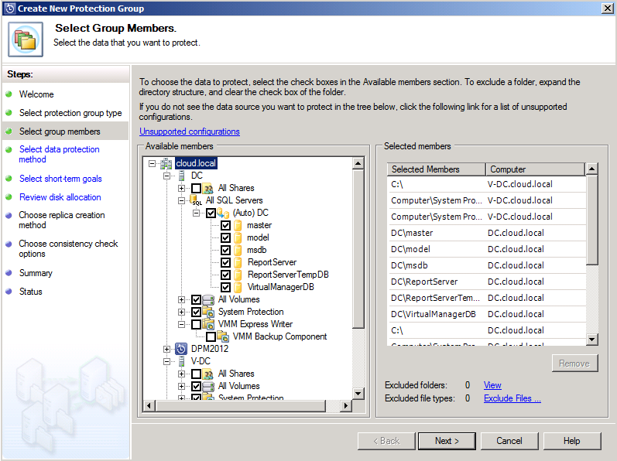
SQL Server protection Granular end-to-end application protection
Integrated backup for SQL Server: Through System Center Data Protection Manager, IT administrators can protect SQL Server at both the VM and SQL Server levels.
Integrates with SQL Server VSS writer and provides the ability to protect SQL Server to disk, tape, or the Microsoft Azure cloud.
Provides advanced database recoverability options beyond those native to SQL Server.
Protects SQL Server data at the instance level as often as every 15 minutes, and recovers at the database level.
Supports protection of highly available SQL Server deployments such as AlwaysOn.
Supports automatic protection of new databases within a protected instance.
Supports self-service recovery for database administrators.
Notes:
We’ve spent a considerable amount of time looking at how we can deploy SQL Server more effectively into the virtualized environment, and in addition, monitor it deeply once deployed, however, what happens in the event of a failure? We talked about clustering, and also Hyper-V Replica as solutions to provide a more real-time solution for hardware or OS failure, but what about if we need to restore SQL Server after an unrecoverable loss? For that, we need to think about backup.
With Data Protection Manager, Microsoft provide a solution to protect key SQL Server workloads, along with SharePoint, Exchange, and Hyper-V VMs, along with the core Windows Server OS, all from the same single agent. When running SQL Server inside a Hyper-V virtual machine, not only can the administrator protect at the VM level, working with both the Hyper-V and SQL VSS writers to coordinate the backup, but additionally, IT administrators can place an agent inside the SQL VMs and gain a more granular, centralized level of backup for the SQL Servers too.
This backup can be made to short term disk, long term tape, or even, through integration with Microsoft Azure, to the cloud for off-site storage and protection.
Non-Microsoft backup solutions tend to take generic backup functionality and adapt it to support-specific applications. In contrast, Microsoft created DPM to leverage fully supported Microsoft technologies in order to provide near-continuous data protection including Windows Server hosts running Microsoft SQL Server. This support includes:
SQL Instance-level protection
Data source co-location, which allows a DPM server to protect over 2,000 databases
Database Administrator Self-Service Recovery
Backup for SQL Server high availability database configurations
Data recovery at database level
DPM is engineered to provide the best possible protection for SQL Server. In fact, the team that built DPM worked in consultation with the team that built SQL Server to ensure that SQL Server workloads are reliably protected. DPM seamlessly interacts in the following ways with the SQL Server VSS writer to capture consistent versions of an SQL deployment without interrupting access databases:
A baseline copy of the SQL Server data can be made using either the DPM block-level synchronization engine or can be done manually.
Express full backups are captured. These backups use the SQL Server VSS writer and DPM agent to identify which blocks have changed in the database and then forward those changed blocks to the DPM server.
Database transaction logs are synchronized with the DPM server as frequently as every 15 minutes between express full backups. DPM synchronizes the log files using a VSS incremental operation.
Best practice is to configure express full backups every evening and more often for transaction log synchronization (between every 15 to 60 minutes).
DPM provides the administrator with flexibility around restoration, supporting restoration to the original, or a different SQL Server, and in addition, the Self-Service Recovery Tool (SSRT) for System Center 2012 R2 – Data Protection Manager (DPM) enables end users to recover SQL Server databases that are backed up by the DPM server, without any intervention from the DPM administrator.
Once a SQL Instance has been protected by DPM, any databases that are added to that instance can be automatically protected, ensuring that the administrator can provide a reliable service to the DBAs yet in an automated fashion.

Slide 70

Microsoft Azure Backup integration Extending Data Protection Manager to the cloud
Microsoft Azure
Reliable offsite data protection: Backups are encrypted before transmission and stored encrypted in Microsoft Azure.
Backups are offsite, away from your datacenter, protected by reliable Azure storage.
DPM
Backup Vault
Simple, and integrated solution: Integrates with UI of Data Protection Manager, simplifying administration and enhancing control.
Efficient and flexible backup and recovery: Supports File Server data, Hyper-V VMs and SQL Server databases.
With UR3 for DPM—retention range of up to 3,360 days (just over 9 years) with 1 sync, every 4 weeks.
Supports synchronization as often as twice per day.
Eases administration by allowing data to be recovered straight from Azure, by using the Data Protection Manager console.
Encrypted data sent to Microsoft Azure
DPM
Protected Servers/Data in Contoso Private Cloud (On-Premises)
DPM Server with the Microsoft Azure Backup Agent installed and configured
Notes:
Just like Windows Server Backup, Data Protection Manager can also integrate with Microsoft Azure Backup, to offer an extra location for storage of key data backups. This provides the following benefits:
- Reduced costs—The Microsoft Azure Backup service can help to reduce the total cost of ownership (TCO) for customers by providing scalability, elasticity, and simplified storage management. - Peace of mind—The Microsoft Azure Backup service provides a reliable, secure, and a robust short-term offsite backup and restore solution that is highly available. - Simplicity—The Microsoft Azure Backup workflows are seamlessly integrated into the existing DPM backup, recovery and monitoring workflows.
Reliable offsite data protection
Backups are encrypted before transmission and stored encrypted in Azure. These backups are off-site, safely away from your datacenter, protected by reliable Azure storage, reducing the need to secure and protect on-site backup media.
A simple and integrated solution
Manage cloud backups from the familiar backup UI in System Center Data Protection Manager. These tools provide similar experiences configuring, monitoring, and recovering backups whether to local disk or Azure storage. Or you can use the agent software itself. After data is backed up to the cloud, authorized users can easily recover backups to any server.
Efficient and flexible backup and recovery
With incremental backups, only changes to files are transferred to the cloud. This helps ensure efficient use of storage and reduced bandwidth consumption, while enabling point-in-time recovery of multiple versions of the data. Configurable data retention policies, data compression, and data transfer throttling offer added flexibility and help boost efficiency.
The following scenarios are supported when protecting data using Microsoft Azure Backup.
DPM server must be on at least Windows Server 2012.
Protection for file system
Protection for virtual machines
Protection for SQL Server databases
Supported file types
Encrypted (Full backups only)
Compressed (Incremental backups supported)
Sparse (Incremental backups supported.
Compressed and sparse (Treated as Sparse)
We are pleased to announce the availability of long term retention for Azure cloud backups in Update Rollup 3 (UR3) for System Center 2012 R2 Data Protection Manager and the latest release of Microsoft Azure Backup. We have integrated the experience in the same configuration screen that you currently use for setting retention policies when using Azure as the target in DPM. You need to select the weekly option that allows you to specify the schedule for longer retention range.
The screenshot shows as sample schedule with a maximum retention of 3360 days. Before explaining the retention range and schedule, it is important to understand how the recovery points are modeled in Azure back-up. Each back-up is stored as a recovery point and we can currently store up to 120 recovery points which is limited to a retention range of 120 days. Although the 120 retention point limit is still in place, we have enhanced the feature to allow a less granular option of weekly back-ups to model a longer retention period.
<next slide>

Slide 71


On premises SQL Server Store, Backup and Recover
Microsoft SQL Server
Direct URL backup
to Azure Storage
Backup and restore database to the cloud
Restore in Azure Virtual Machine
SQL Server Management Studio
Benefits
Reliable off-site data backup for SQL images
Easily restore databases using VMs

Slide 72

SQL backup to Microsoft Azure storage
Natively built into SQL

Slide 73
SQL Server back-up to the cloud
Key Benefits
Windows Azure
Geo replication
Reduce CAPEX & OPEX
Improve Data Security
Restore Backup to Azure VM
Full SQL Server Backup
Storage
Restore to VM
Full data encryption
Periodic Snapshot (automatic/manual)
On-premise network
SQL Server
Notes:
Now backing up to the cloud is not a direct Windows Azure VM hybrid scenario as you are primarily using Windows Azure storage for the backup, but the VM comes into play in the case you want to restore the backup quickly in the cloud. TCO is a theme that carries through to this scenario as well as you are only paying for storage utilized. In addition you also gain automatic geo replication that is built into Azure storage, which give you better data security. We have built UI right into SQL Server management studio to make the full SQL Server backup capabilities easy to implement at a database or SQL Server instance level. We have also added a key feature which customers have been asking for, which is full data encryption. What’s nice about the data encryption solution is the you hold the encryption keys not Windows Azure for greater compliance and security.
You can setup the backup process manually or we also have a new backup policy recommendation solution built-in to SQL Server 2014 that will allow you to automate the backup up process to Windows Azure based on data usage.

Slide 74

SQL Server disaster recovery in the cloud
Key Benefits
Reduce CAPEX & OPEX
Low RTO disaster recovery
Speed global BI reporting
Windows Azure
Run backups
Run BI reports
On-premise network
Domain controller
Secondary replica
VPN tunnel (Windows Azure Virtual Network)
Synchronous commit
Asynchronous commit
Primary replica
Secondary replica
“Recovery times have dropped from minutes to seconds… We’re seeing almost no data loss.”
Recover in seconds
Significant cost reductions
Notes:
One of the most powerful hybrid scenarios we are making even easier to implement with SQL Server 2014 is a low RTO disaster recovery solution for your on-premises SQL Servers. You can do this by now being able to add AlwaysOn replicas directly to Windows Azure Virtual Machines. Now as you see in the diagram, we recommend having your asynchronous replicas residing in Azure VMs and your synchronous replica on-premises. Again the reason for that is you want to minimize the impact on your primary, so having the synchronous close by is ideal. Now this is still a low RTO (recovery time objective) solution as the way asynchronous replication works, is as soon as the transaction is committed it is on it’s was to the replica in Azure, so data loss in minimal.
The other big gain in this scenario is that AlwaysOn replicas are readable so you can take advantage of the global Azure data center to strategically place the replicas (remember you can have up to 8 now with SQL Server 2014, double that of SQL Server 2012). This means faster global BI reporting in addition to a more cost effective disaster recovery solution.
Lufthansa has already started to take advantage of this and not only seen cost reductions but also much faster recovery times over their previous data base mirroring and log shipping methodology.
We have built UI into SQL Server management studio to make the deployment of AlwaysOn replicas even easier whether on premises or in Windows Azure.
Optional Talk Track (if ISVs are in room):
Now for those of you that are ISVs this scenarios not only gives you the cost savings benefits, but also gives you a revenue opportunity with Windows Azure, much like Manhattan Associates has done. Manhattan Associates builds mission critical software for medical equipment distributors like Buffalo Hospital, that manages logistics. What Manhattan Associates realized was that they could use this new database DR capabilities to offer a value added DR service to it’s clientele. This was a win for the client Buffalo Hospital as they didn’t want to have to deal with setting up DR for Manhattan Associates mission critical app, they would much rather pay additional money to Manhattan Associates to provide this as a service and thus creating a new revenue stream for Manhattan Associates.
http://www.microsoft.com/casestudies/Microsoft-SQL-Server-2014/Lufthansa-Systems/Lufthansa-Systems-Cuts-Data-Recovery-Time-from-Minutes-to-Seconds-with-Cloud-Solution/710000003603

Slide 75

Azure SQL Database
Enterprise-grade database-as-a-service
Provision and pay-as-you-go
Elastic scale up, scale out
Microsoft-backed database-as-a-service with 99.99% uptime SLA
Streamlined business continuity with automatic backups and geo-replication
Compliant, secure and auditable
Self-managed with near zero admin

Slide 76
Data protection
Basic, Standard & Premium databases are protected from accidental data corruption, deletion & disaster
Automatic, continuous backups
Retention varies by service tier: Basic 7 days, Standard 14 days, Premium 35 days
Daily backups also copied to a remote datacenter
“Oops” recovery
Self-service point-in-time restore from local backups, including deleted databases
Data center disaster
Self-service restore from remote backups to any region at any time
No charge for backups, normal database rates apply for restored databases

Slide 77
Elastic scale out
Simplified development & management of high-throughput applications scaled out across a large number of databases
Scale to thousands of databases using sharded database pattern
Implemented via .NET client libraries consumed by the application
Supports add, split, and merge shards with data movement
Clients can merge query results from multiple shards
Asynchronous management operations across shards (index maintenance, DDL, DML)
SQL Database Shards

Slide 78




Point In Time Restore
RA-GRS
sabcp01bl21
Automatic Backup
Full backups weekly, diff backup daily, log backups every 5 min
Daily and weekly backups automatically uploaded to geo-redundant Azure Storage
Self-service restore
REST API, PowerShell or Portal
Creates a new database in the same logical server
Tiered Retention Policy
Basic - 7 days
Standard - 14 days
Premium - 35 days
sabcp02bl21
sabcp03bl21
Copy backups to Azure Storage
LS XYZ
DB
Backups
DB1
Backups
Restore as a new database from local backups

Slide 79
Summary: Azure SQL
SQL Database Shards
Relational database-as-a-service
Elastic Scale and Performance
Business Continuity and Data Protection
Self-managed and Familiar
Predictable performance levels
Scale up/down & out/in
Dashboard views of DB metrics
Self-service restore
Disaster recovery
Compliance-enabled
Self-managed
Programmatic APIs
Familiar tools and language

Slide 80
Azure SQL Database Service Tiers
Basic
Standard
Premium
Intended Use
Light transactional loads
Go-to option for most business applications
High throughput and business-critical databases
Availability
99.99%*
Size
2 GB
250 GB
500 GB
Performance
•
••
•••
Business Continuity
•
••
•••
Incremental performance and features with easy upgrade and downgrade
*The 99.99% availability SLA does not apply to Web and Business editions, which continue to be supported at 99.9% availability.

Slide 81
Azure Backup for Azure IaaS VMs Application-consistent backup of virtual machines
Azure
Backup with no impact to production workloads
No shut down of VM required
Application level consistency for Windows OSes
File system level consistency for Linux OSes

Slide 82
Fabric level backup
Azure Backup for Azure IaaS VMs
Unlimited scalability, with no customer resources required for backup
Agentless backup of multiple VMs at the same time
Single, central management interface through the Azure portal
Detailed Jobs view for tracking progress and success/failure
Azure

Slide 83
Policy-driven backup and retention
Azure Backup for Azure IaaS VMs
Configuration of scheduled backup
On-demand backup
Automatic management of recovery points within Azure Backup vault
Retain backup data in Azure Backup vault even if the original VM is deleted
Azure

Slide 84

Backup an Azure IaaS VM
In three simple steps
Azure

Slide 85
DEMO
Azure IaaS VM Backup
Notes:
Demo Objective: Step through the process of adding a VM to a backup.

Slide 86

Summary Microsoft Azure Backup
Simple and reliable server backup to the cloud
Convenient offsite protection
Secure – only you have the key
Integrates with Microsoft backup tools
Notes:
Let’s look at what we’ve discussed today.
Thinking back to the data protection challenges, we know that as data rates grow, organizations need a solution that is simple, reliable, and cost-effective.
Microsoft Azure Backup provides a simple, reliable backup solution that utilizes an enterprise-class storage system in Azure to deliver secure offsite protection. All this functionality comes with using Microsoft’s backup tools.
You can get started with Microsoft Azure Backup today.
Let’s end with a look at the three simple steps to get you going.

Slide 87
Some slides to explain how standard VMs in Azure can be used to:
Replicate SQL with SQL Always On
Replicate Domain Controllers
Host an Exchange DAG Witness

Slide 88



Azure hybrid usage scenarios
S
Sync copies of data to your “other” datacenter
S
S
AD Repl
Web
File
SQL
AD/DNS
AD/DNS
SQL DB Mirroring / AlwaysOn
80/443
VPN Tunnel
SQL
Fileservers
Web Based Applications
Cloud Service
File
Web
Microsoft Azure Virtual Network
On-Premises

Slide 89
Lunch Time: Lab 1: Backup an Azure VM

Slide 90

Azure Site Recovery Backup / Migration scenarios
Virtual or Physical machine to Azure
(VMware & Hyper-v)
Target: Microsoft Azure
Source: On-premise
AWS VM to Azure
Source: AWS
Target: Microsoft Azure
Azure to Azure
Source: Microsoft Azure
Target: Microsoft Azure

Slide 91
ASR Pricing
Free protection for any server for the first 31 days – for both migration and recovery
No additional cost to migrate servers to Azure when migration is completed within the first 31 days – only pay for resources that you consume in Azure
Standard ASR pricing applies after 31 days

Slide 92



How ASR works
Process Server
Customer 1
Source: VMware VMs & Physical Machines
Microsoft Azure Site Recovery
DataCenter 1
Customer 2
Target: Microsoft Azure
Data Channel
Process Server
Source: VMware VMs & Physical Machines
Microsoft Azure
Microsoft Azure
DataCenter 2
Mobility Service – Captures all data writes from memory
Process Server – Used for Caching, Compression & Encryption
Master Target – Used as a repository & for retention
Config Server – Used for Centralized Management

Slide 93
DEMO
Azure Site Recovery
Notes:
Demo Objective: Step through ASR

Slide 94

ASR & System Center VMM Disaster recovery to a second site with Hyper-v
Microsoft Azure
Site Recovery Manager
Communication Channel
Replication channel: Hyper-V Replica
Windows Server
Primary Site
Recovery Site
Windows Server

Slide 95
ASR & System Center VMM Disaster recovery to a second site with SAN replication
Microsoft Azure Site Recovery
Communication channel
Replication channel: SAN Replication
Enterprise / HSP Primary site
Enterprise / HSP Recovery site
Windows Server
Windows Server

Slide 96


Microsoft Azure Site Recovery How it works: Recovery plans
Primary site
System Center
Virtual Machine
Manager
AD
SQL
LOB
12. Create recovery plan
System Center
Virtual Machine
Manager
AD
SQL
LOB
Secondary site
Notes:
Once the VM’s have been replicated, and are fully protected, the user needs to create a Recovery Plan, which will help to coordinate the failover between sites.
<next slide>

Slide 97

Microsoft Azure Site Recovery How it works: Executing recovery plans
Primary site
AD
System Center
Virtual Machine
Manager
AD
SQL
SQL
LOB
LOB
13. Execute recovery plan
15. When primary site is back online, execute a reverse replication
16. When reverse replication completes, a planned failover returns active VMs to the primary site
14. Azure Site Recovery orchestrates VMs starting on secondary site
AD
System Center
Virtual Machine
Manager
AD
SQL
SQL
LOB
LOB
Secondary site
Notes:
<click>
In the event of an outage, or even if we just want to test failover, we need to execute the recovery plan.
<click>
The Recovery Plan runs in Microsoft Azure, and…
<click>
Site Recovery starts the orchestrated failover of VMs in the secondary location.
<click>
When the primary site is back online, the user can execute a reverse replication, and replication from secondary, back to primary will begin.
<click>
Once completed, the user can initiate a planned failover, back to the primary site, without any data loss.
<next slide>

Slide 98
Orchestrated disaster recovery Across on-premises, service provider locations or both
Microsoft Azure Site Recovery
Microsoft Azure Site Recovery
Communication Channel
Communication and Replication
Replication channel: Hyper-V Replica
Windows Server
Primary Site
Recovery Site
Windows Server
Primary Site
Windows Server
Key features include:
Automated VM protection and replication
Remote health monitoring
Customizable recovery plans
No-impact recovery plan testing
Orchestrated recovery when needed

Slide 99
Azure Site Recovery One solution for multiple infrastructures
SHARE Standards Group – 7 Tiers of Disaster Recovery
Tier 0 – No off-site disaster recovery plan
Tier 1 – Data backup with no hot site
Tier 2 – Data backup with hot site
Tier 3 – Electronic vaulting
Tier 4 – Point-in-time copies
Tier 5 – Transaction Integrity
Tier 6 – Zero or near-zero data loss
Tier 7 – Highly automated business integrated solution
Azure Site Recovery
Protect your data, your applications, or both—at your site, a hoster’s site, or in Microsoft Azure
Notes:
But what, fundamentally, is Azure Site Recovery? Well, Azure Site Recovery can help you protect important applications by coordinating the replication and recovery of private clouds across sites, whether you’re protecting dozens – or hundreds of virtual machines. You can protect your applications to your own second site, a hoster’s site, or even use Azure as your disaster recovery site and avoid the expense and complexity of building and managing your own secondary location.
But where does this fit on the Seven Tiers of DR? The Seven Tiers of Disaster Recovery was originally defined by SHARE to help identify the various methods of recovering mission-critical computer systems as required to support business continuity. Although the original known published concept dates back to the 1990s, Business Continuity Planning (BCP) and Disaster Recovery specialists today continue to use the 7 Tiers to illustrate continuity capabilities and costs at a very high level. The definitions for the various Tiers have been updated as technology has evolved in support of today's business requirements and their associated Recovery Time Objective (RTO) and Recovery Point Objective (RPO).
Tier 0: No off-site data – Possibly no recovery
Businesses with a Tier 0 business continuity solution have no business continuity plan. There is no saved information, no documentation, no backup hardware, and no contingency plan. The time necessary to recover in this instance is unpredictable. In fact, it may not be possible to recover at all.
Tier 1: Data backup with no hot site
Businesses that use Tier 1 continuity solutions back up their data and send these backups to an off-site storage facility. The method of transporting these backups is often referred to as "PTAM" - the "Pick-up Truck Access Method." Depending on how often backups are created and shipped, these organizations must be prepared to accept several days to weeks of data loss, but their backups are secure off-site. However, this tier lacks the systems on which to restore data.
Tier 2: Data backup with a hot site
Businesses using Tier 2 business continuity solutions make regular backups on tape. This is combined with an off-site facility and infrastructure (known as a hot site) in which to restore systems from those tapes in the event of a disaster. This solution will still result in the need to recreate several hours or even days' worth of data, but the recovery time is more predictable.
Tier 3: Electronic vaulting
Tier 3 solutions build on the components of Tier 2. Additionally, some mission critical data is electronically vaulted. This electronically vaulted data is typically more current than that which is shipped via PTAM. As a result there is less data recreation or loss after a disaster occurs. The facilities for providing Electronic Remote Vaulting consists of high-speed communication circuits, some form of channel extension equipment and either physical or a virtual tape library and an automated tape library at the remote site. IBM's Peer-to-Peer VTS and Oracle StorageTek Virtual Storage Manager (VSM) Clustering are two examples of this type implementation.
Tier 4: Point-in-time copies
Tier 4 solutions are used by businesses that require both greater data currency and faster recovery than users of lower tiers. Rather than relying largely on shipping tape, as is common on the lower tiers, Tier 4 solutions begin to incorporate more disk based solutions. Several hours of data loss is still possible, but it is easier to make such point-in-time (PiT) copies with greater frequency than tape backups even when electronically vaulted.
Tier 5: Transaction integrity
Tier 5 solutions are used by businesses with a requirement for consistency of data between the production and recovery data centers. There is little to no data loss in such solutions; however, the presence of this functionality is entirely dependent on the application in use.
Tier 6: Zero or near-zero data loss
Tier 6 business continuity solutions maintain the highest levels of data currency. They are used by businesses with little or no tolerance for data loss and who need to restore data to applications rapidly. These solutions have no dependence on the applications or applications staffs to provide data consistency. Tier 6 solutions often require some form of Disk mirroring. There are various synchronous and asynchronous solutions available from the mainframe storage vendors. Each solution is somewhat different, offering different capabilities and providing different Recovery Point and Recovery Time objectives. Often some form of automated tape solution is also required. However, this can vary somewhat depending on the amount and type of data residing on tape.
Tier 7: Highly automated, business integrated solution
Tier 7 solutions include all the major components being used for a Tier 6 solution with the additional integration of automation. This allows a Tier 7 solution to ensure consistency of data above that which is granted by Tier 6 solutions. Additionally, recovery of the applications is automated, allowing for restoration of systems and applications much faster and more reliably than would be possible through manual business continuity procedures.
So where does Azure Site Recovery come in?
<click>
Tier 7. This means that Azure Site Recovery can offer the lowest levels of recovery time, and the highest value for customers, and when combined with the other components within the Microsoft solutions, helps customers to protect all of their mission critical applications and data.
<next slide>

Slide 100

Summary: Azure Site Recovery One solution for multiple infrastructures
Replication
Replication
SAN
SAN
Replication
Hyper-V
Microsoft Azure
Hyper-V
Hyper-V
Hyper-V
Hyper-V
1
Hyper-V to Hyper-V (on-premises)
2
Hyper-V to Hyper-V (on-premises)
3
Hyper-V to Microsoft Azure
Replication
Replication
Replication
Microsoft Azure
Microsoft Azure
Microsoft Azure
VMware or Physical
VMware
VMware or Physical
4
VMware or Physical to VMware (on-premises)
5
VMware or Physical to Microsoft Azure
6
Azure to Azure
Protect your applications to your own second site, a hoster’s site, or Microsoft Azure as your disaster recovery site.
Notes:
What are the different infrastructures that Azure Site Recovery can provide a solution for?
Well first, for customers who have multiple sites, or work with a service provider as a secondary site, and Hyper-V is running on both sites, they can take advantage of Azure Site Recovery to orchestrate the replication and recovery between those sites. In that example, the engine of replication will be Hyper-V Replica, an inbox VM replication technology that’s built into Windows Server 2012 and 2012 R2.
<click>
For customers with an investment in SAN technology, that includes replication in the box, through integration with Hyper-V, System Center and Azure Site Recovery, customers can orchestrate the replication and recovery of their key workloads between those sites, this time, harnessing the power of the SAN, through asynchronous or synchronous replication, to transfer data between sites.
<click>
For customers who don’t have a second site, and are running Hyper-V on their primary site, using Azure Site Recovery, customers can orchestrate the replication and recovery of their on-premises workloads, into the Microsoft Azure datacenters, enabling this as a target for failover in the event of a disaster. The engine of replication in this example is Hyper-V Replica.
<click>
What about customers who don’t have Hyper-V within their datacenters? Well, as we mentioned at the start of the presentation, with the acquisition of InMage, under the umbrella of Azure Site Recovery, customers can orchestrate the replication and recovery of key workloads from physical, or VMware-based sites, over to a secondary site, running VMware also. This time, InMage Scout is providing the replication engine, and is transferring the data between the two on-premises locations.
<click>
Finally, just like we saw earlier, where a customers without a secondary location, could use ASR to replicate and recover Hyper-V-based VMs into Azure, with the new InMage technologies, in the future, you will be able to replicate and recover VMware-based VMs into Microsoft Azure. Again, this will be powered by InMage Scout.
<click>
So let’s dive into each of these in more detail, starting with Hyper-V to Hyper-V replication and recovery with ASR.
<next slide>

Slide 101
VIDEO
Azure Site Recovery
Notes:
AODRecovery_high.mp4

Slide 102
Operations Management Suite
Your business continuity in one pane of glass
It’s simple
Time to value
Easy to integrate
A single portal for all your management tasks. No infrastructure to maintain.
Onboard fast. No content to create. Connects to your on-premises datacenter.
Add new servers, or connect to your existing management tools within minutes.
Hybrid and open
Extend System Center
Manage workloads across Windows and Linux, hybrid and public clouds, Azure and AWS.
Complements your System Center investment to unleash new management scenarios.

Slide 103


Operations Management Suite Capabilities
Log analytics
Backup & Recovery
IT Automation
Security & Compliance
Effortless log collection
Integrated fast search and queries with custom dashboard
Integrated cloud backup
Seamless disaster recovery and workload migration
Hybrid runbook worker
Graphical workbook authoring and automation DSC
Malware assessment
Security posture and system update assessment
With OMS capabilities customers can…
Spot problems fast
Protect data easily
Automate tasks quick
Recognize threat early
extending System Center capabilities, as an all-in-one management solution!

Slide 104
Operations Management Suite (OMS)
Simplified guest and workload management anywhere (on-premises or in the cloud)
LINUX
HYPER-V
LINUX
HYPER-V
WINDOWS
WINDOWS
LINUX
VMware
LINUX
VMware
WINDOWS
WINDOWS
Public Cloud
AZURE or AWS
Private or Hosted Third Party Cloud
Rackspace etc.,
Microsoft
Operations Management Suite
HYPER-V
LINUX
WINDOWS
VMWare
LINUX
WINDOWS
LINUX
WINDOWS
ON-PREMISES WITH SYSTEM CENTER

Slide 105
VIDEO
Operations Management Suite Overview
Notes:
Microsoft Operations Management Suite Overview.mp4

Slide 106
Summary
Summary
Try Windows Server and System Center Technical Preview
Microsoft has a breadth of solutions that help deliver business continuity and disaster recovery for all workloads within your environment.
Adding Microsoft Azure brings powerful new capabilities for backup and site recovery.
Microsoft solutions help you to lower the costs and complexity associated with business continuity and disaster recovery.

Slide 107


Microsoft Virtual Academy & Channel9.MSDN.com
Free online training
Short videos on How-To: http://aka.ms/azureshorts
Virtual Academy – Azure for DR: http://aka.ms/mvaazuredr
Virtual Academy – Azure for AWS: http://aka.ms/mvaazureaws
Virtual Academy – Azure Virtual Machine Fundamentals: http://aks.ms/mvaazurevms
Lead to Certification
Knowledge Tests
Live Online Events
Notes:
Replace AKA link with your own if desired.

Slide 108
Implementing Microsoft Azure Infrastructure Solutions Exam 70-533
Implement websites (16%)
Deploy websites
Configure websites
Configure diagnostics, monitoring, and analytics
Configure scale and resilience
Manage hosting plans
Implement virtual machines (18%)
Deploy workloads on Azure virtual machines (VMs)
Implement images and disks
Perform configuration management
Configure VM networking
Configure VM resiliency
Design and implement VM storage
Monitor VMs
Implement cloud services (16%)
Configure cloud services and roles
Deploy and manage cloud services
Monitor cloud services
Implement storage (16%)
Implement blobs and Azure files
Manage access
Configure diagnostics, monitoring, and analytics
Implement SQL databases
Implement recovery services
Implement an Azure Active Directory (16%)
Integrate an Azure AD with existing directories
Configure the Application Access Panel
Integrate an app with Azure AD
Implement virtual networks (17%)
Configure a virtual network
Modify a network configuration
Design and implement a multi-site or hybrid network
Find a Study Guide at http://earlyexperts.net
Notes:
https://www.microsoft.com/learning/en-us/exam-70-533.aspx#AzureCert
20533A: Implementing Microsoft Azure Infrastructure Solutions (five days)

Slide 109
Did you Enjoy Today’s Event?
Complete an online evaluation for today’s event …
Tell us what was great and where we can improve …
Let us know your thoughts around future event topics …
Insert Link Here ☺

Slide 110
TechNet on Tour Azure labs
Lab 0: Login to the Azure Portal
Lab 1: Backup an Azure VM
Lab 2: Using Azure Backup
Lab 3: Copy Files with AZCopy
Lab 4: (optional) Backup your laptop to Azure

Slide 111

© 2015 Microsoft Corporation. All rights reserved. Microsoft, Windows, Windows Vista and other product names are or may be registered trademarks and/or trademarks in the U.S. and/or other countries.
The information herein is for informational purposes only and represents the current view of Microsoft Corporation as of the date of this presentation. Because Microsoft must respond to changing market
conditions, it should not be interpreted to be a commitment on the part of Microsoft, and Microsoft cannot guarantee the accuracy of any information provided after the date of this presentation.
MICROSOFT MAKES NO WARRANTIES, EXPRESS, IMPLIED OR STATUTORY, AS TO THE INFORMATION IN THIS PRESENTATION.

Slide 112







Accelerating cloud content with BranchCache
Secure IPSec Site-to-Site VPN Tunnel
Hosted Cache Server
4
Encrypted Content Cache
Content Server
2
\\SERVER\SHARE
3
1
VPN Gateway
VPN Gateway
AD / DNS
Windows 8.1 Enterprise
AD / DNS / DHCP
On-Premises Network
Microsoft Azure Virtual Network
Notes:
Slide Objective: Describe scenarios for accelerating file and web content access from the Cloud
Key Talking Points:
BranchCache in Windows Server 2012 R2 and Windows 8.1 Enterprise can be leveraged to accelerate file and web content delivery to local PC’s from virtual machines provisioned on a Microsoft Azure Virtual Network
BranchCache can be configured in a Hosted Cache Server configuration, as depicted, or in a Distributed Cache configuration for small single-subnet branch office networks.
With BranchCache configured, when client attempts to access cloud-based file or web server, server returns set of IDs that describe content
Client checks local Hosted or Distributed cache to determine if IDs are cached locally.
Content matching IDs is returned from local cache, while content that is a cache miss is retrieved from original content server.
Content retrieved from original server is sent to cache for accelerating future access attempts.
In this configuration, writes always are sent to original content server directly
This configuration has been tested to deliver up to a 2,000:1 reduction in network traffic by reducing retransmission of common data blocks.
More details: http://blogs.technet.com/b/keithmayer/archive/2013/05/06/diy-accelerating-the-cloud-with-branchcache-in-windows-server-2012.aspx

Slide 113
Port Forwarding Input Endpoints
Cloud Service
VIP- 137.135.64.110
DIP-192.168.1.7
PORT 5586
PORT 3389
Endpoint
Public Port
Local Port
Protocol (TCP/UDP)
Name
VM1
LB/IP
DIP-192.168.1.15
PORT 5587
PORT 3389
VM2
Single Public IP Per Cloud Service

Slide 114



Azure Infrastructure Services
Load-Balanced Set
Cloud Service
Endpoint
VM & Data Disks
Private port
Public port
Availability Set
AutoScaling
DIP
Incoming Requests
DIP
…
Regional Vnet
VIP
Load
Balancer
DIP
DNS
DIP
Site-to-Site gateway
Point-to-Site
gateway
VIP - Public IP assigned by Azure and bound to a cloud service
DIP – Internal IP assigned by Azure to the vNIC of a VM via DHCP
Endpoint – a pair of a public port and a private port for communicating with a cloud service

Slide 115




Hybrid Cloud Connectivity
OnPremNet
Microsoft Azure
CloudNet
On-Premises Network
Subnet 10.2.1.0 / 24 - Web
Site-to-Site IPSec VPN tunnel
System Center
SQL
IIS
IIS
SharePoint
IPv4 Public Address
Subnet 10.2.0.0 / 24 - Gateway
Highly Available Active / Passive
AD / DNS
VPN Gateway
VPN Gateways
Site-to-Site ExpressRoute tunnel
Subnet 10.2.2.0 / 24 - Core
Exchange
BranchCache
File
AD / DNS
SQL
IP Address Space: 10.1.0.0/16
IP Address Space: 10.2.0.0/16

Slide 116

ExpressRoute
Site-to-Site VPN
ExpressRoute:
Exchange Provider
ExpressRoute:
MPLS Network Provider
Public
internet
Public
internet
Customer site 3
Microsoft Azure
Microsoft Azure
Customer site 2
WAN
Customer DC
Microsoft Azure
Customer site
ExpressRoute
partner location
Customer site 1
Public
internet
Connect via an encrypted link over public internet
Peer at an ExpressRoute location, an Exchange Provider facility
Connection from a WAN provided by Network Service Provider (e.g. telco).
Azure becomes another site on the customer’s WAN network.
Virtual Network - Compute only.
ExpressRoute - Provides customer choice and include access to compute, storage, and other Azure services.

Slide 117

Microsoft BizSpark
Microsoft BizSpark is a global program that provides free software, support and visibility to help startups succeed. There are 50K startups in BizSpark in 100+ countries. The three year program is free of charge and gives startups:
Eligibility
To qualify, startups must be:
Developing Software
Privately held and generating less than U.S. $1M in revenue per year
Less than 5 years old
Tools
Support
Visibility
$150 of monthly Microsoft Azure benefits for 3 years to quickly build, deploy and manage web & cloud apps
Apply for up to $60K of additional Azure benefits.
Three year access to current, full-featured software development tools
Professional technical and product support
Unique and valuable offers from the BizSpark Network Partners to help run your business
Two free MSDN Support Incidents.
Profile, Offers and Events
A connection to the BizSpark ecosystem, giving startups access to investors, advisors and mentors
Opportunities to achieve marketing visibility
http://aka.ms/BizSparkStartup

